Slide 1
Notehub: Android & Django Development
Presenters: JD Mauthe, Alan Luu
Faculty Advisor: Yusuf Pisan
Sponsors: Aaron Vega, Aden Shukuroff

Slide 2
TABLE OF CONTENTS
Introduction
01
Process
02
Front-End Development
03
Back-End Development
04
Usability Testing
05
Experience
06
Goals & Project Overview
Roles, Rapid Application Development, and Tools & Technology
Walkthrough of Application
Back-End Architecture
SUS, SEQ, Completion, & Student Feedback
Helpful Courses & Knowledge Gained

Slide 3
01
Introduction
Goals & Project Overview

Slide 4
Goal
Provide a platform for new or current students to share notes
Expose them to a variety of notes
In doing so, teach them new ways of organizing their notes
Provide additional resources, so students can succeed in their classes

Slide 5
Project Overview
NoteHub:
Android application
Platform for universities students to share notes
Supported by a backend created with Django
Main Features:
Upload Notes
Download Notes
Search Notes
View Notes
Private Groups
Comment
Favorite
Rate

Slide 6
02
Process
Roles, Rapid Application Development, and Tools & Technology

Slide 7
Roles
Front-End Development (Alan):
Design UI
Develop Android application
Perform usability tests
Back-End Development (JD):
Develop back-end using Django
Assist integrating API into Android application
Perform usability tests

Slide 8
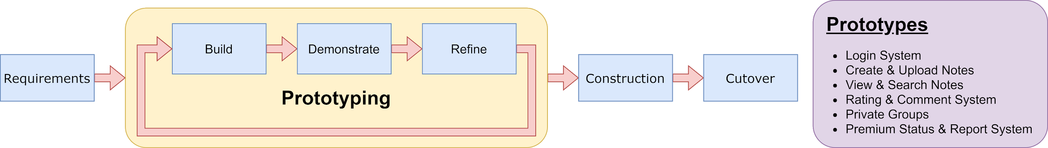
Rapid Application Development (RAD)
Prototyping:
Prototype for every week
Focus on specific features
Showed to sponsors for feedback
Use feedback to improve prototype
Construction:
Combine prototypes into working application
Start usability testing for feedback
Use feedback for final adjustments

Slide 9











Tools & Technology
Front-End
Both
Back-End

Slide 10
Front-End Development
03
Walkthrough of Application

Slide 11
Types of Users
Free
Premium
Moderator
User’s with limited features
Can only join 3 groups
Max upload size: 15 MB
Has access to all features
Unlimited groups
Max upload size: 50 MB
An owner of a group
Can add or remove users
Can delete any note in group

Slide 12
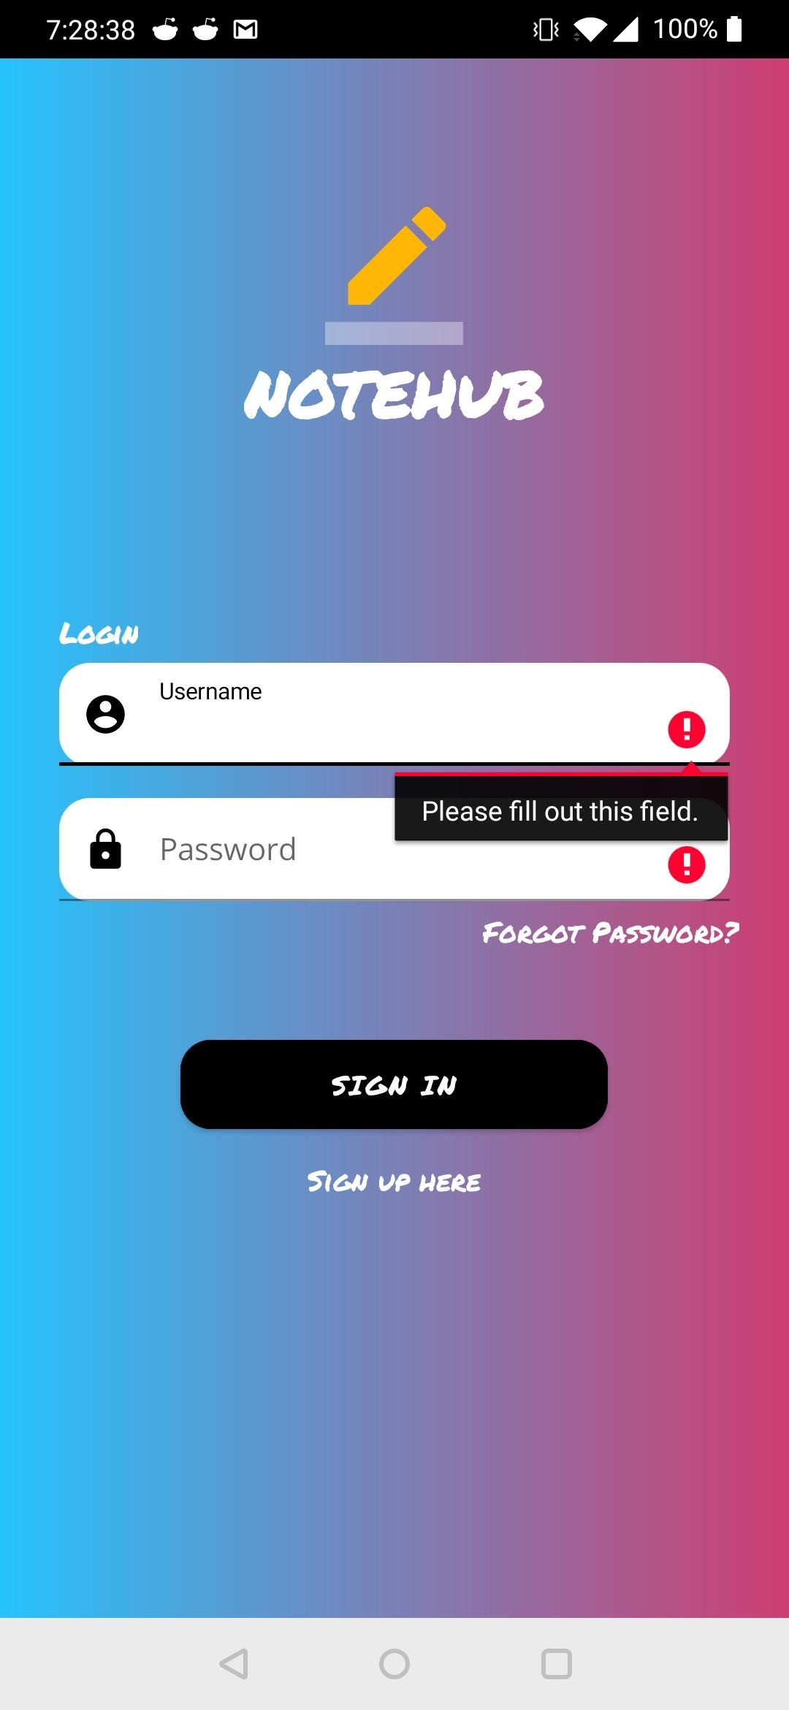
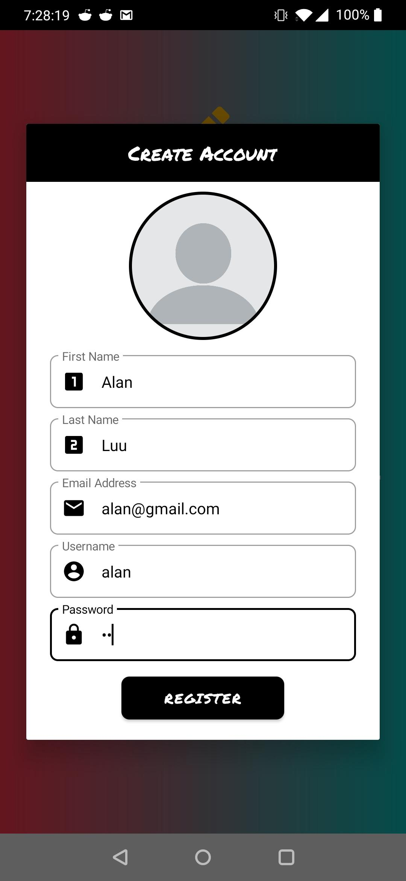
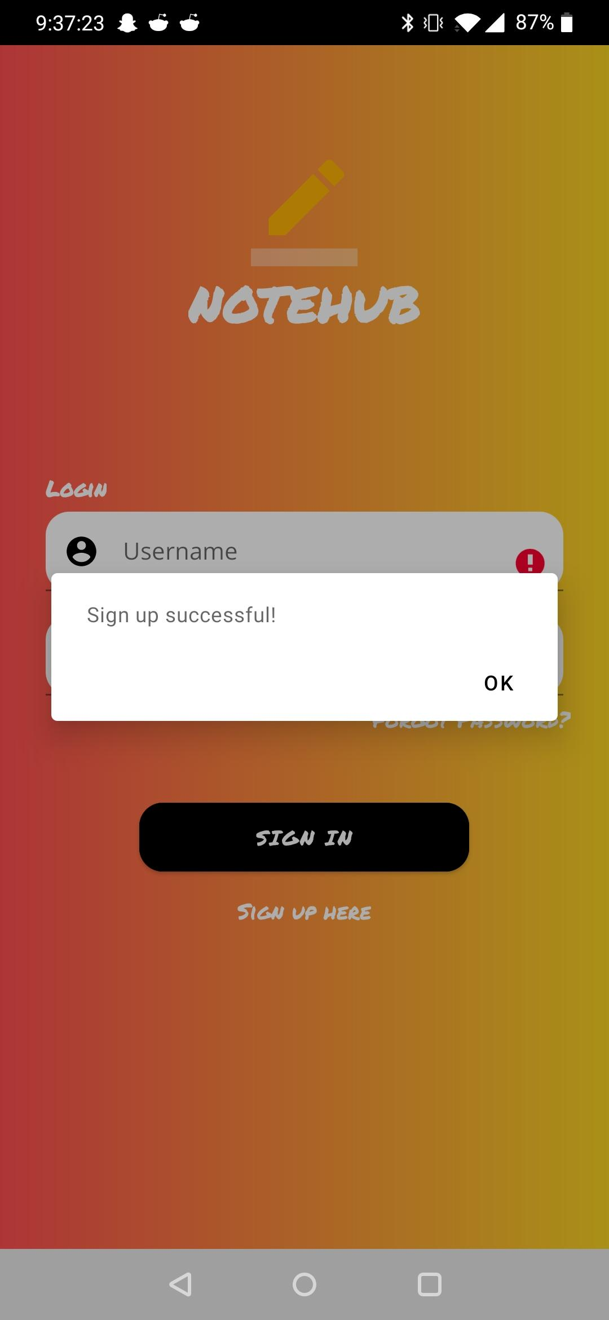
Sign In

Slide 13
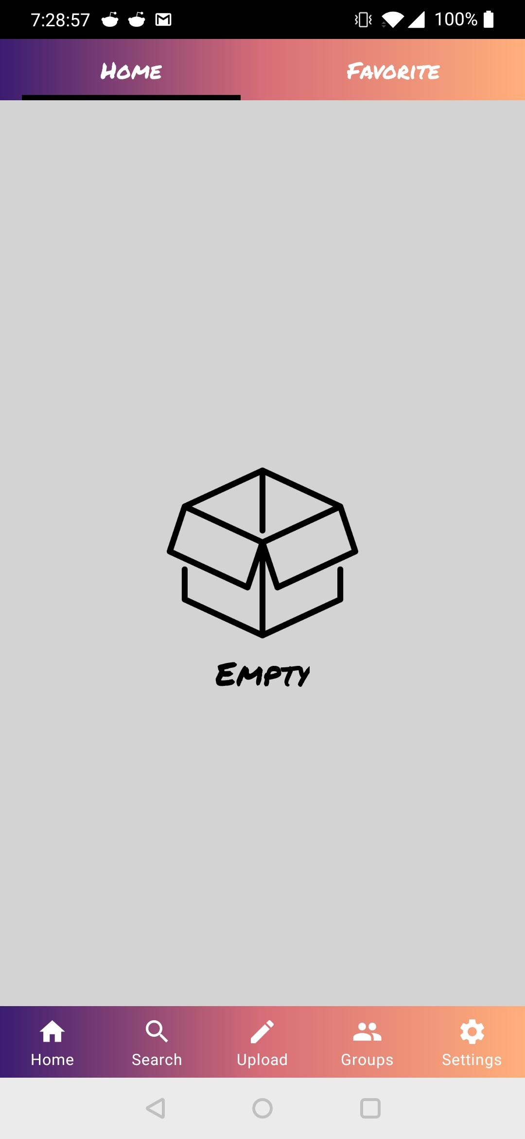
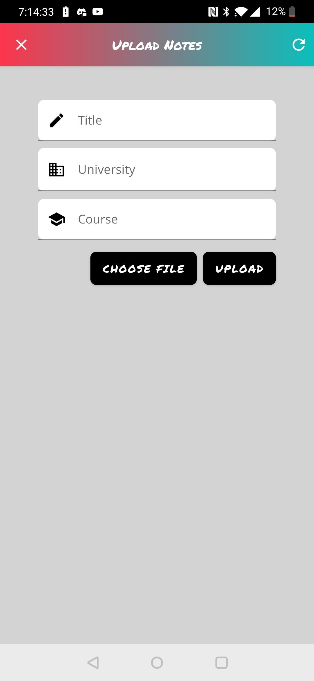
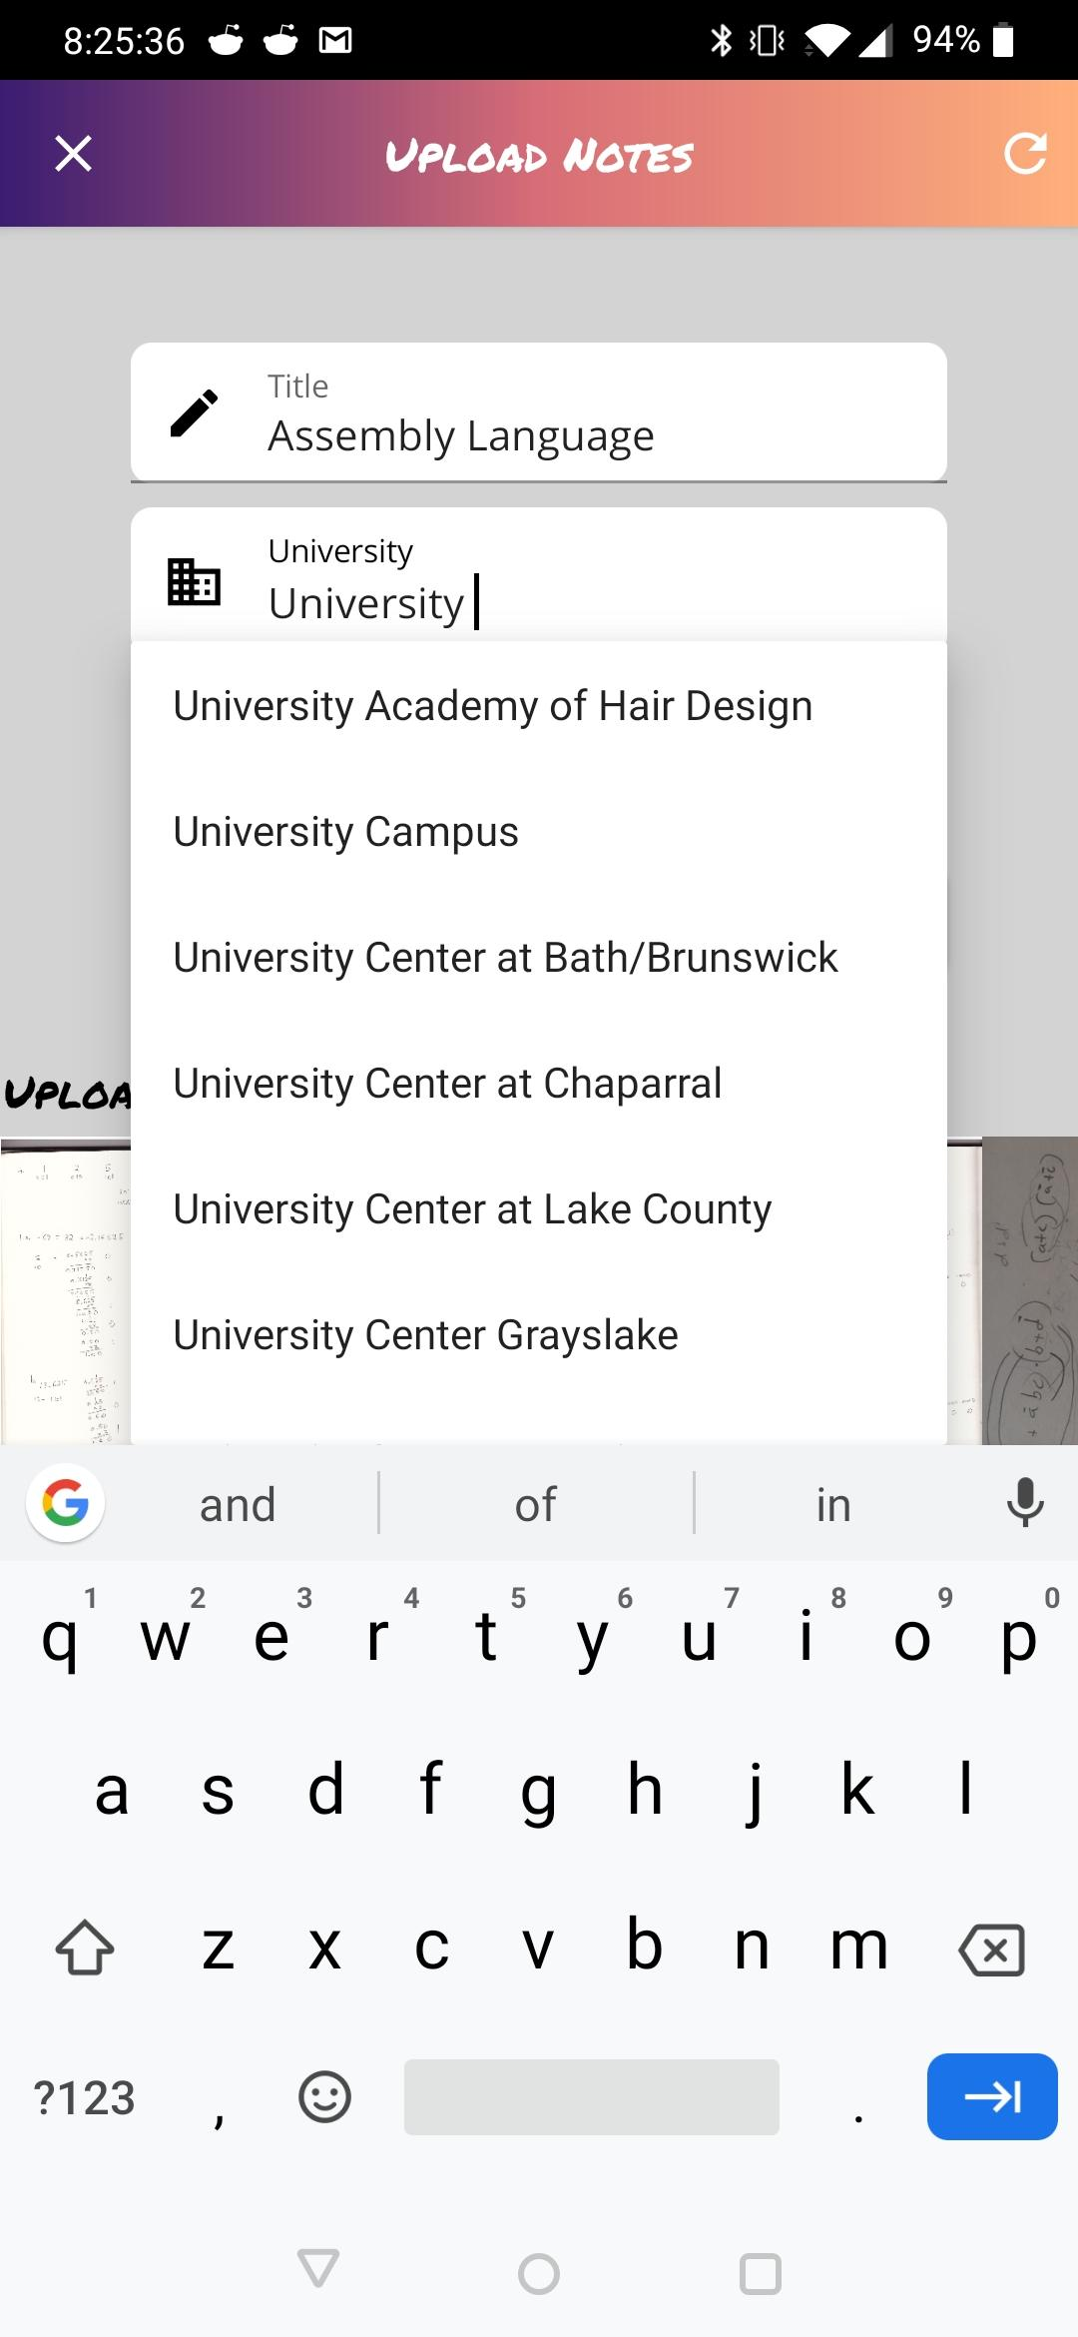
Upload

Slide 14
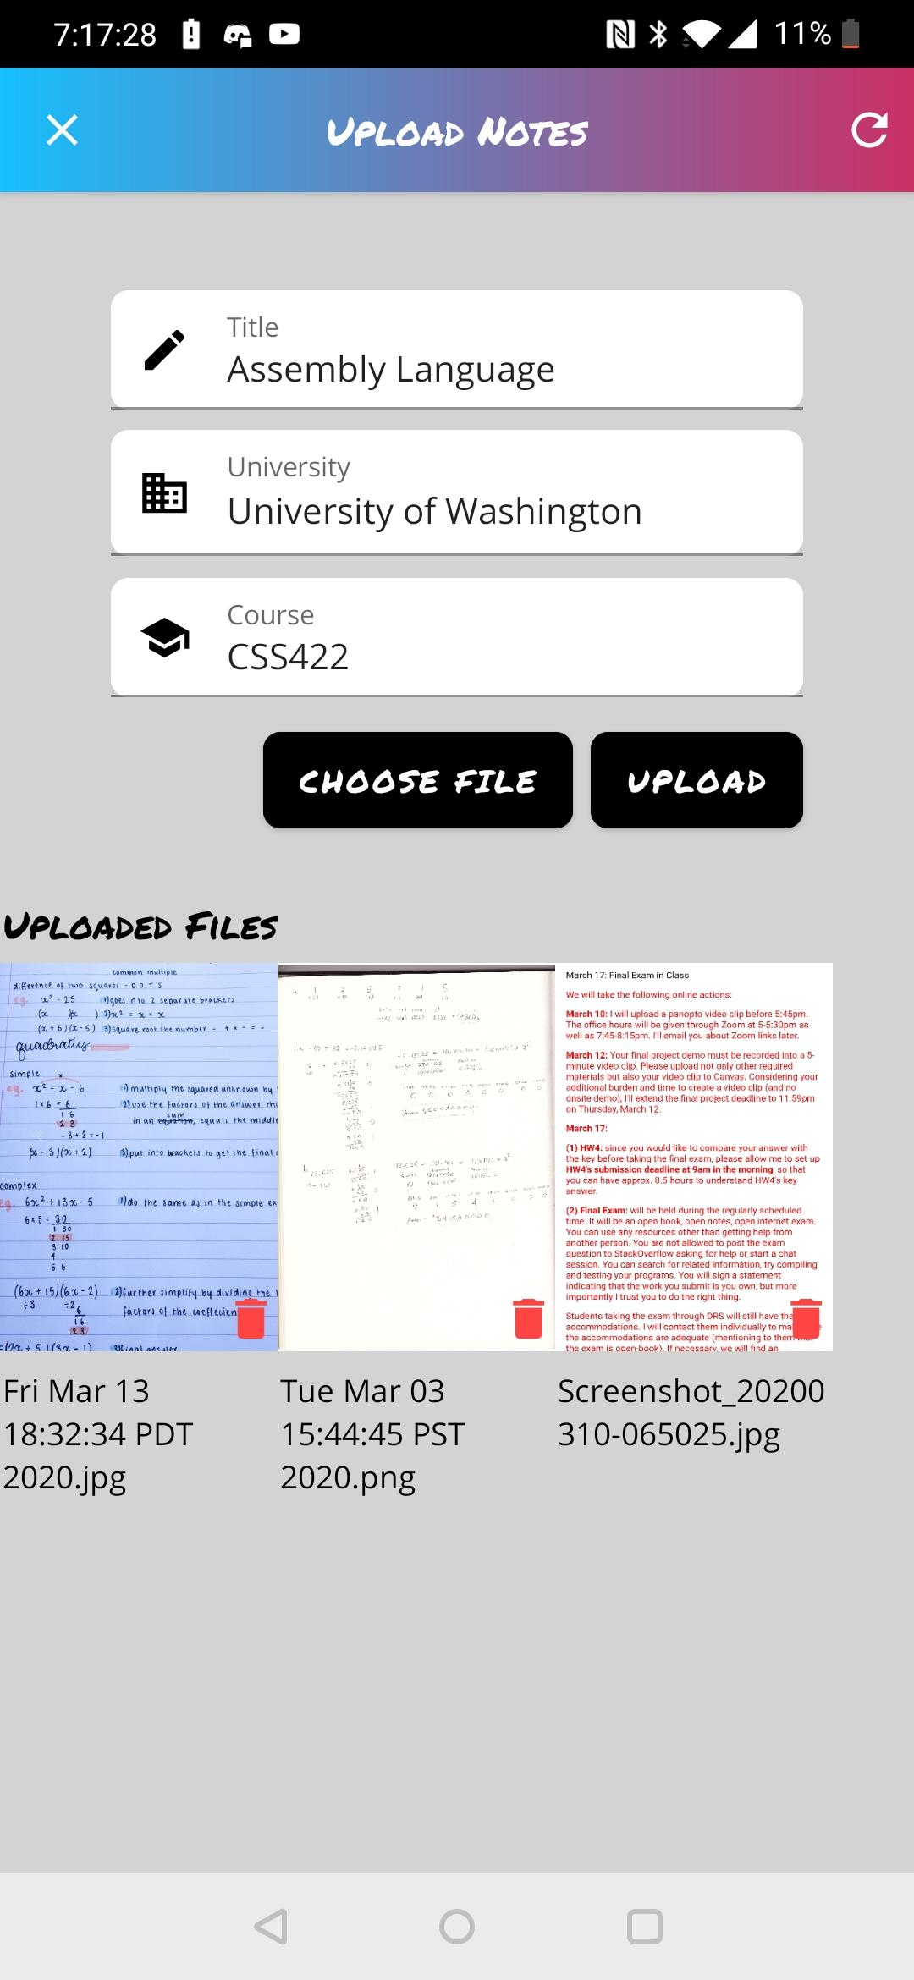
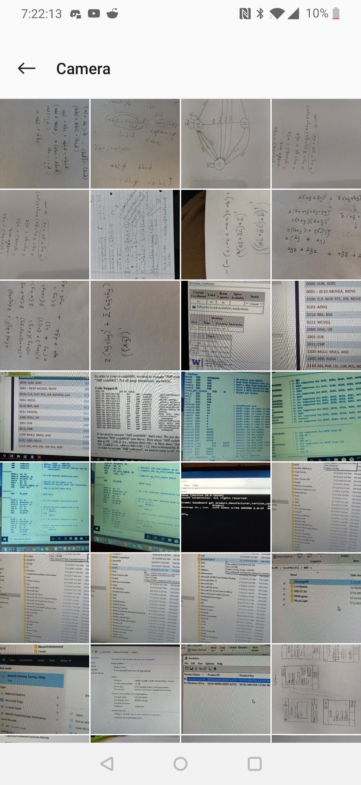
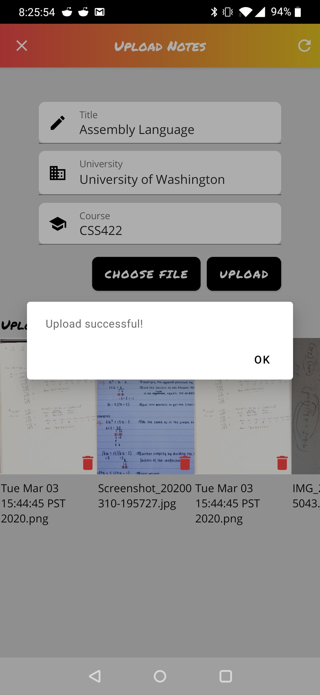
Upload Files

Slide 15
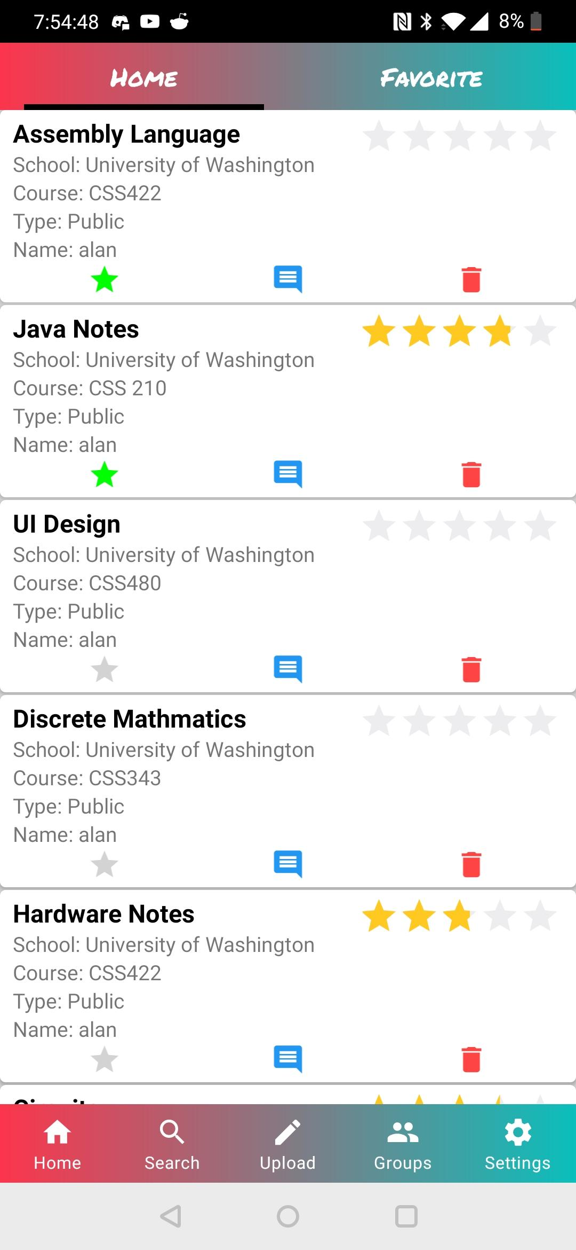
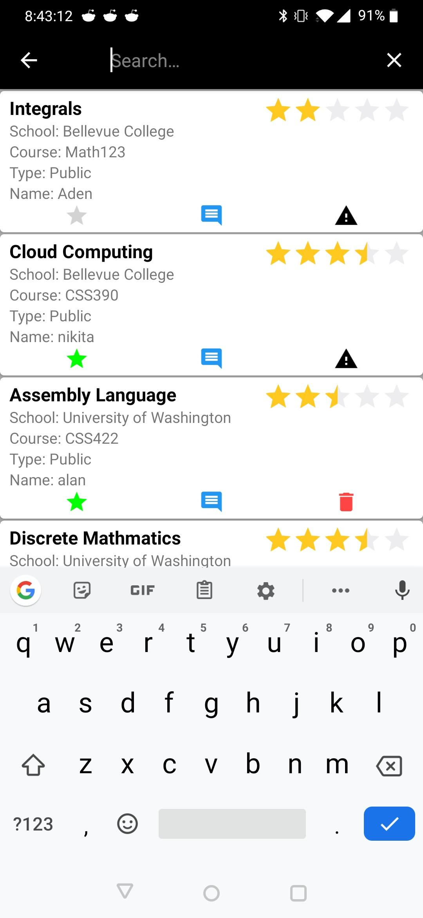
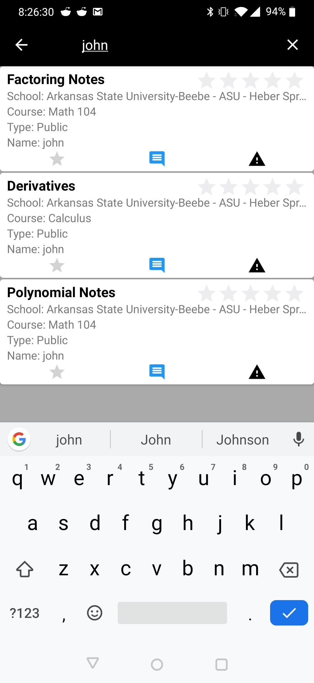
Search

Slide 16
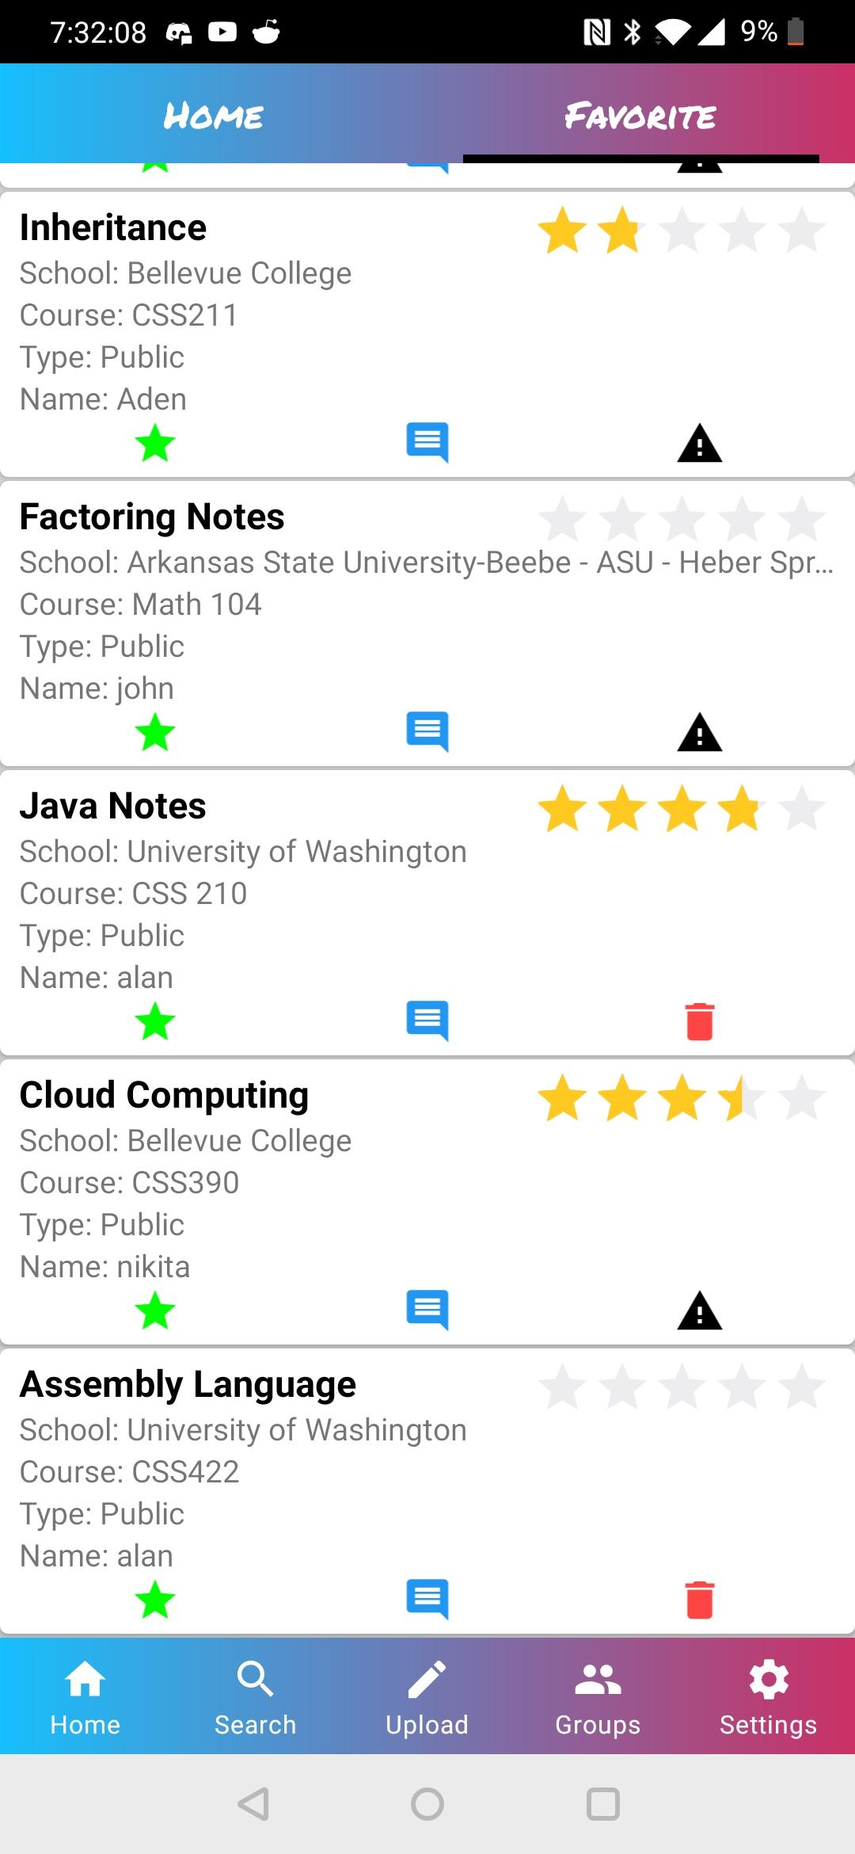
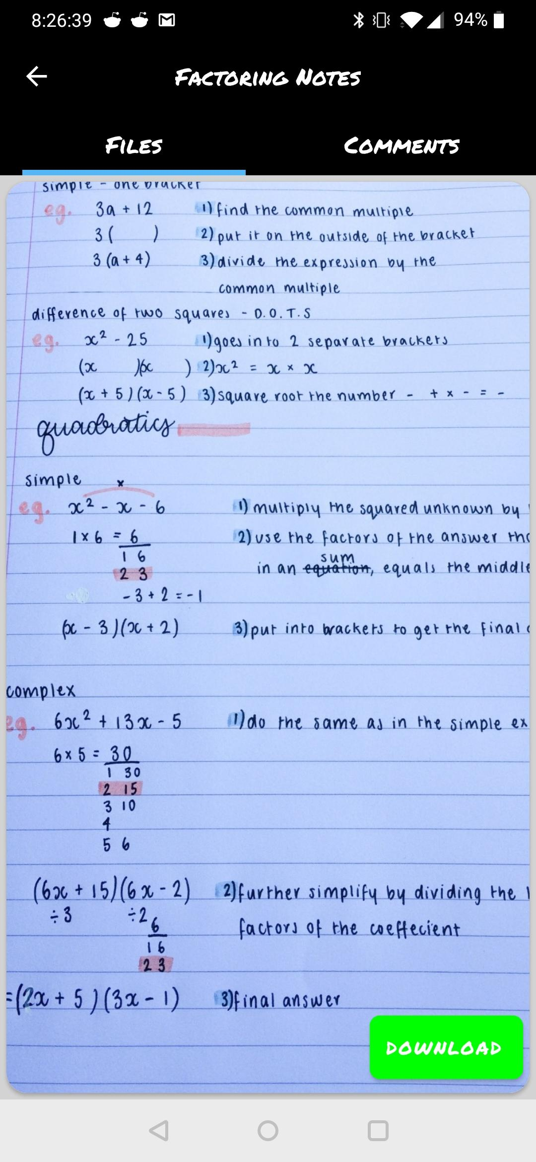
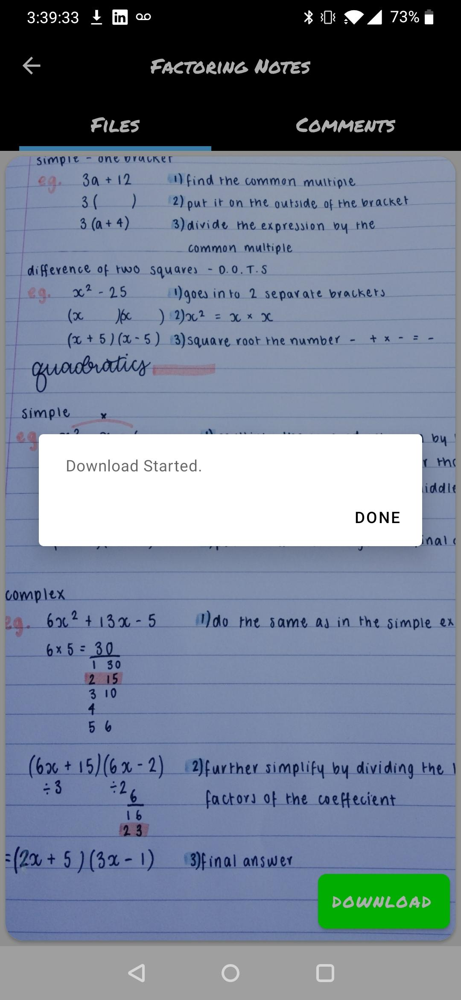
Inner Note Files View

Slide 17
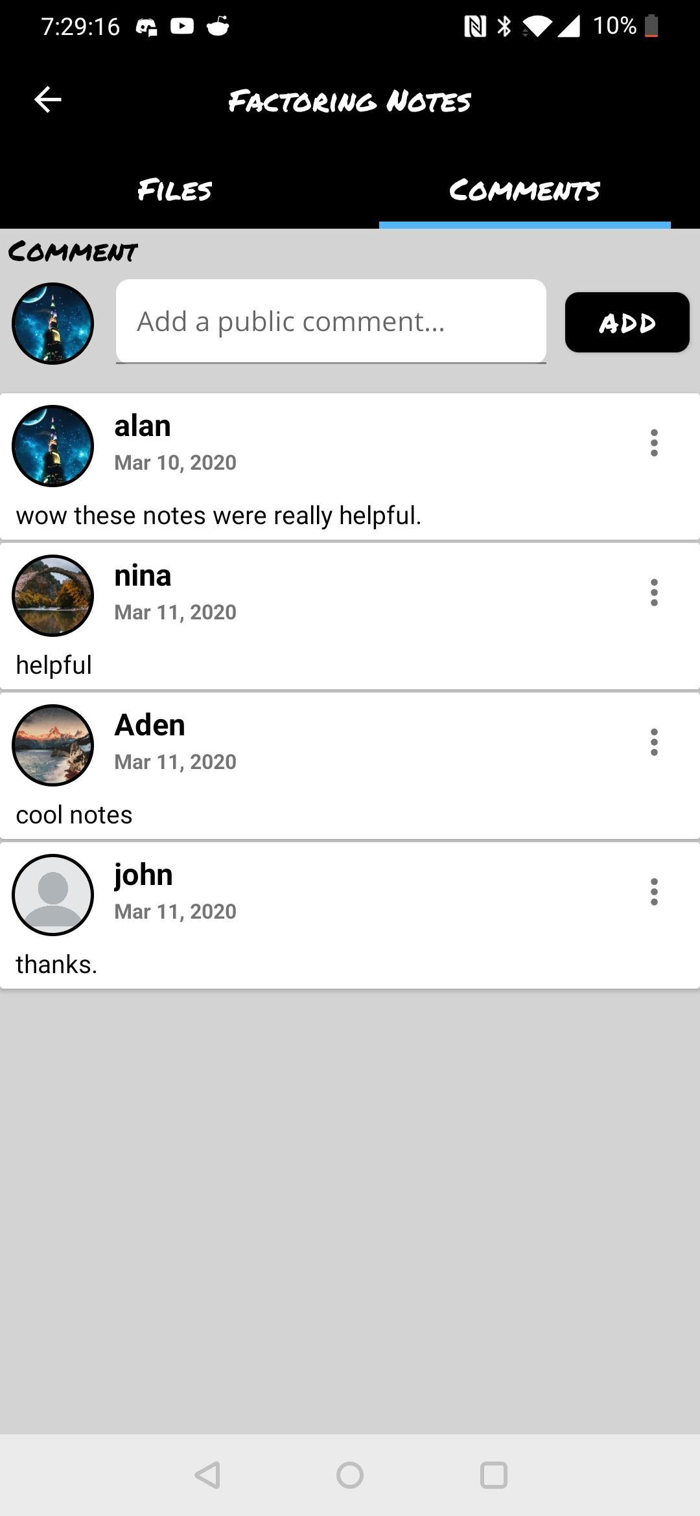
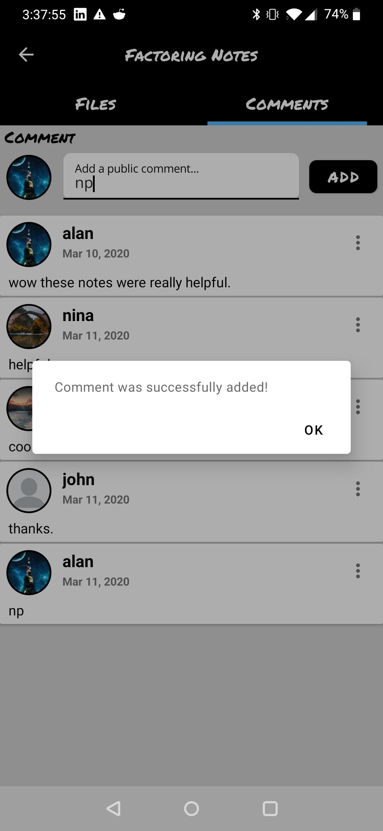
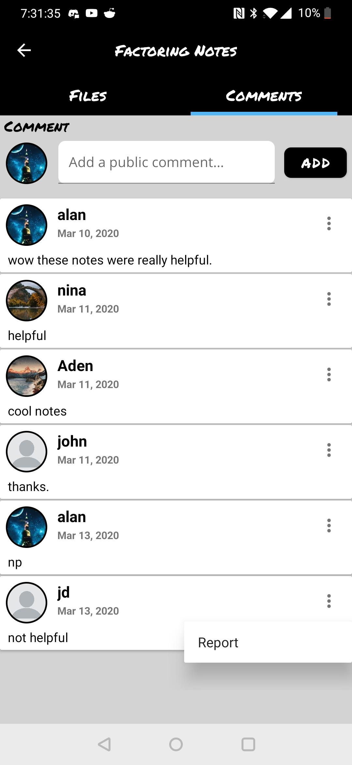
Inner Note Comments View

Slide 18
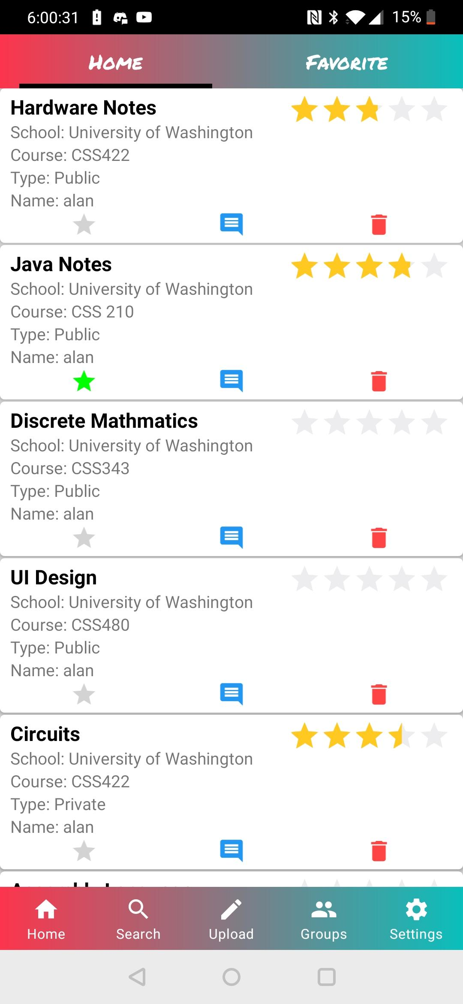
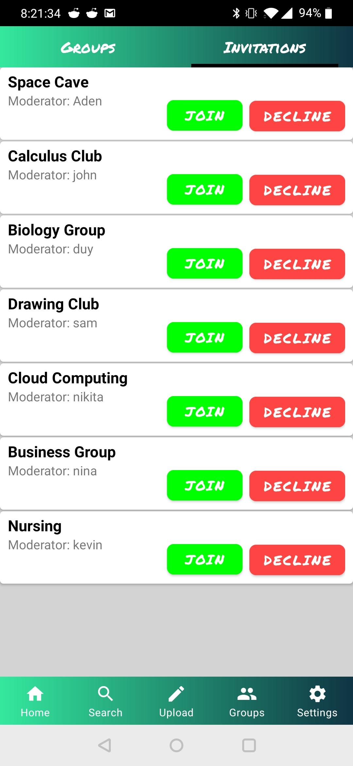
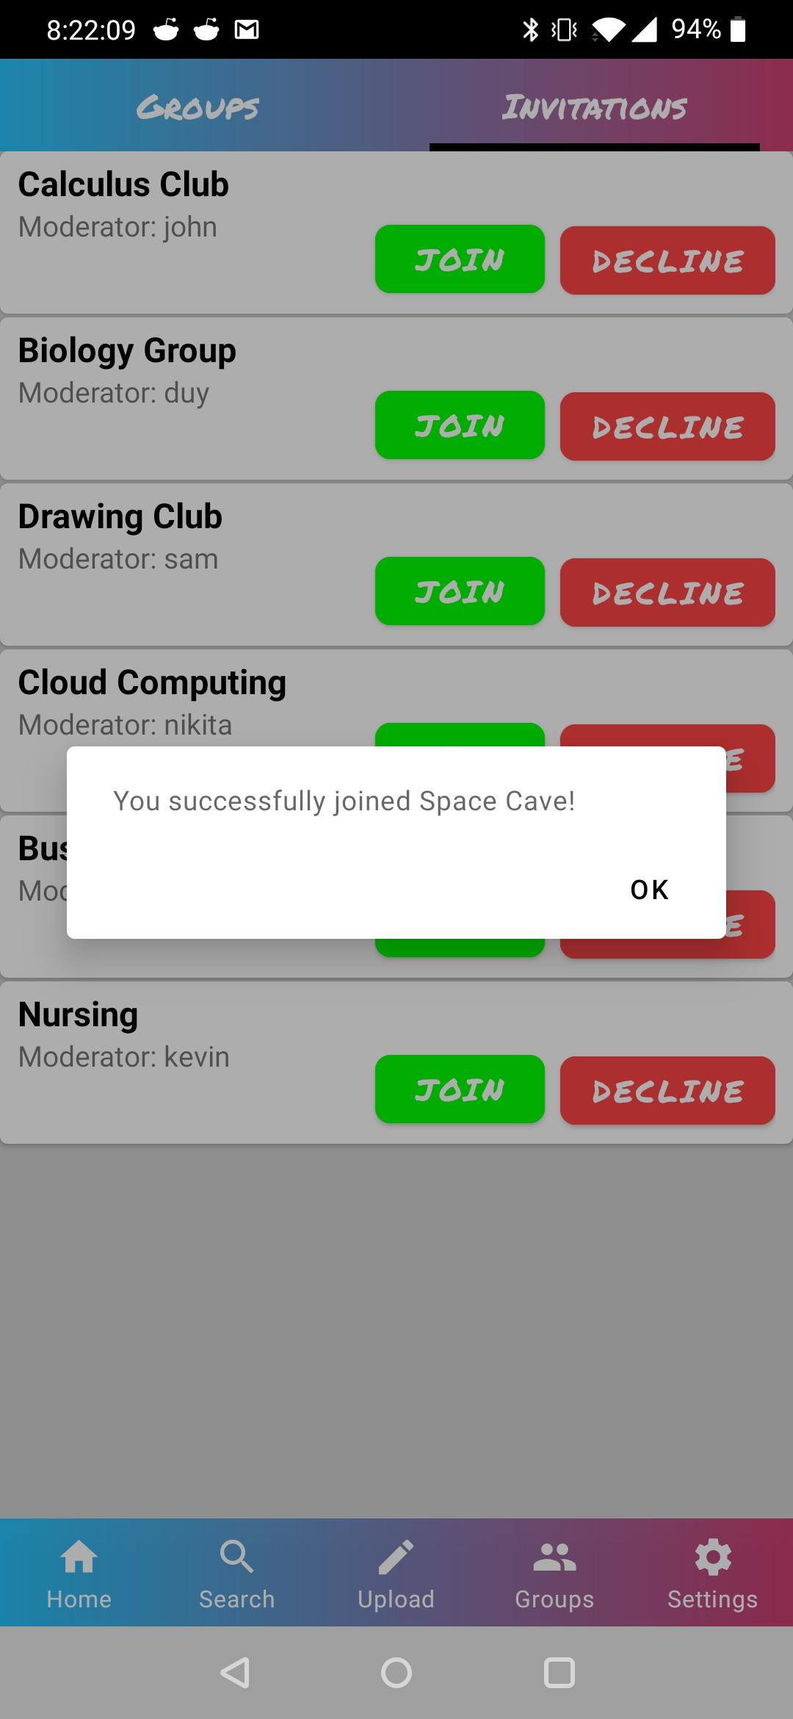
Group Invitations

Slide 19
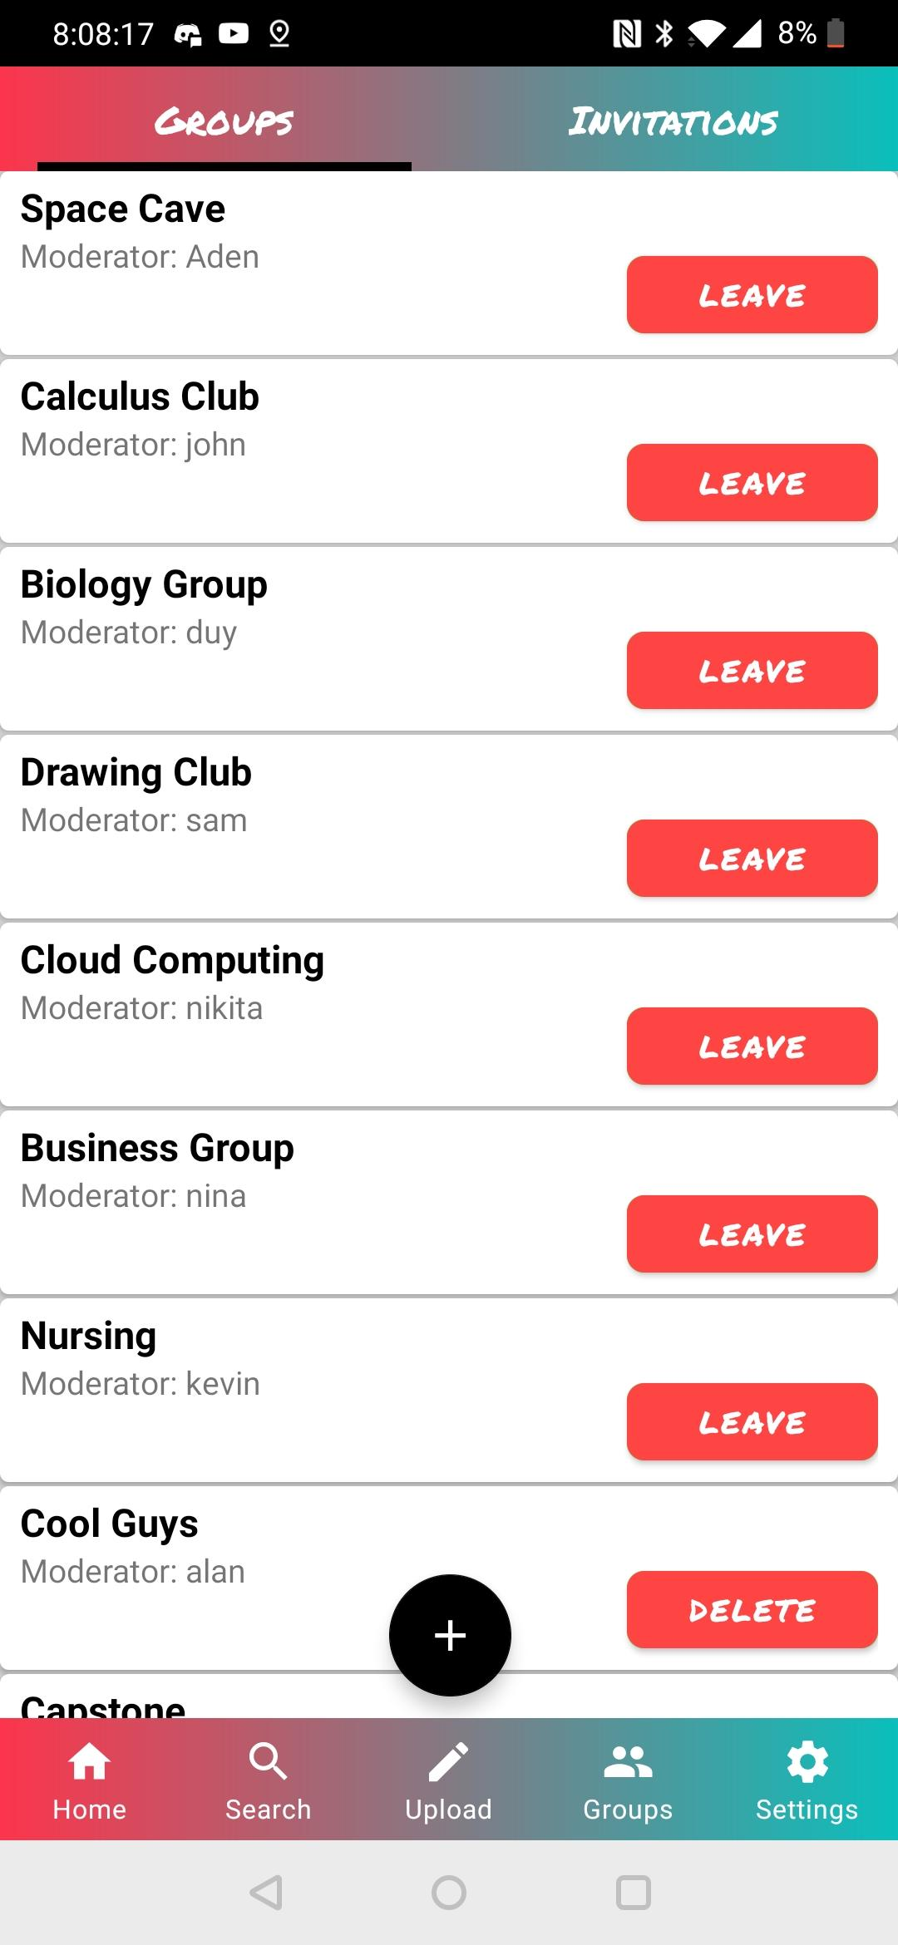
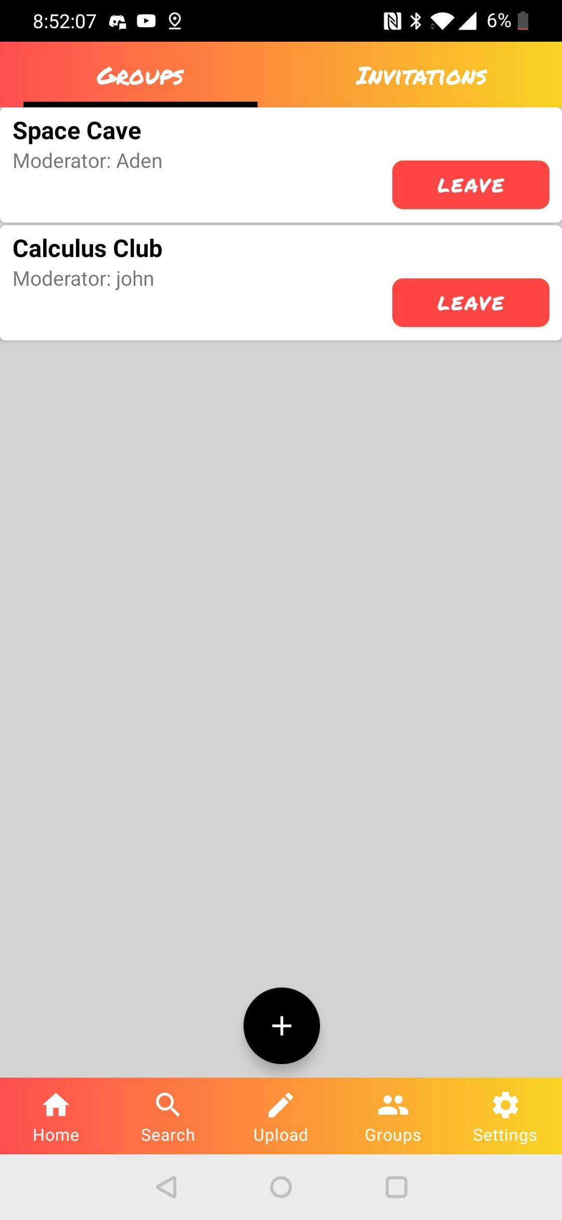
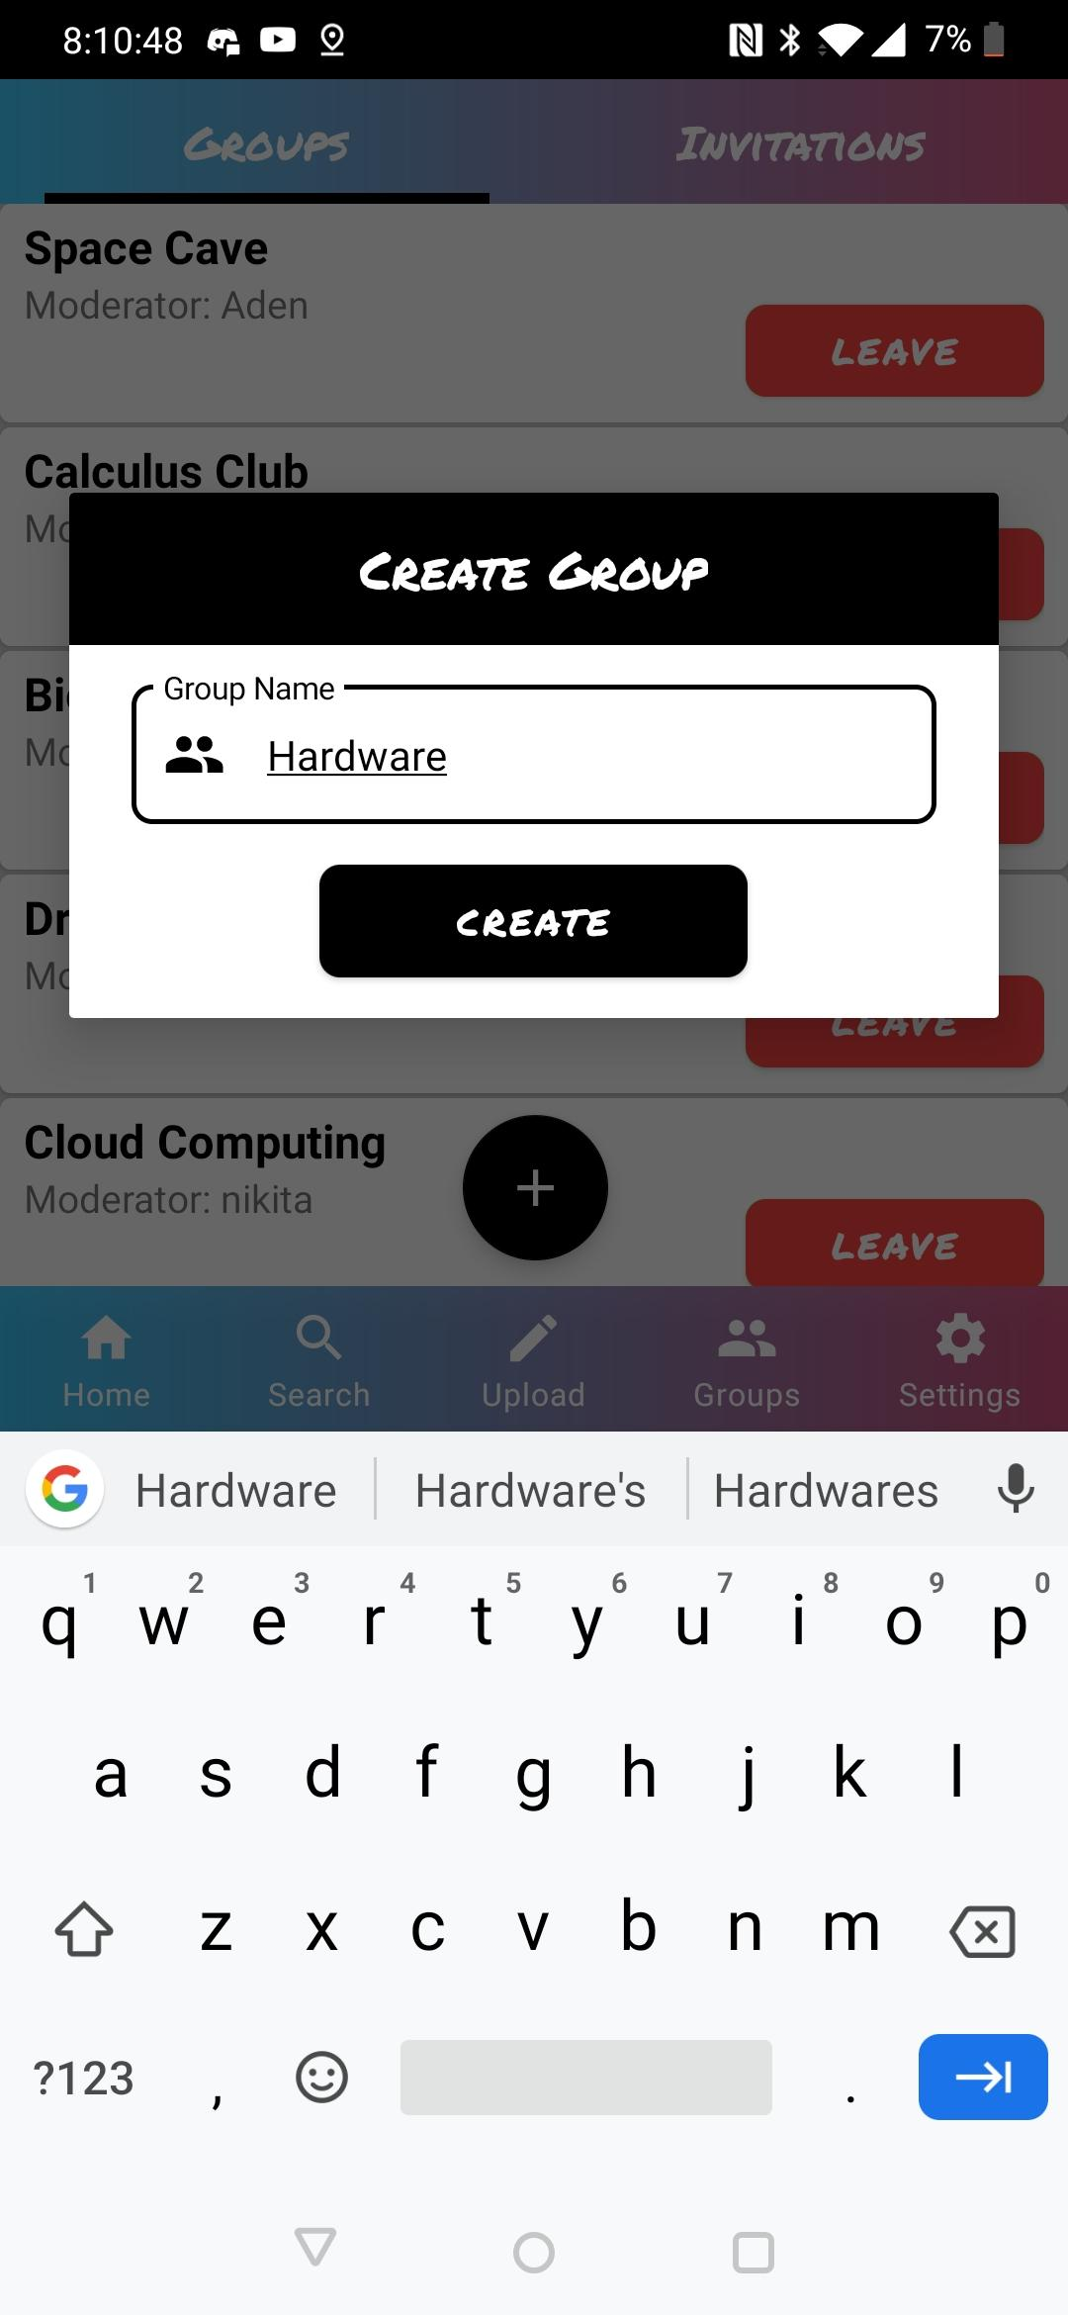
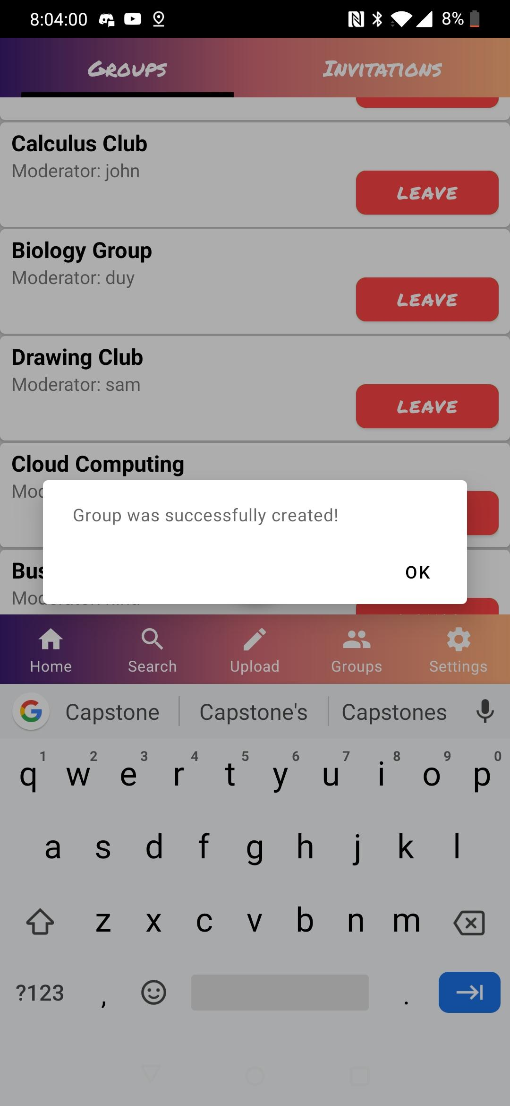
Groups

Slide 20
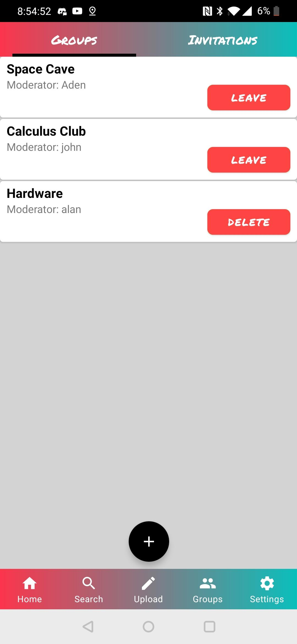
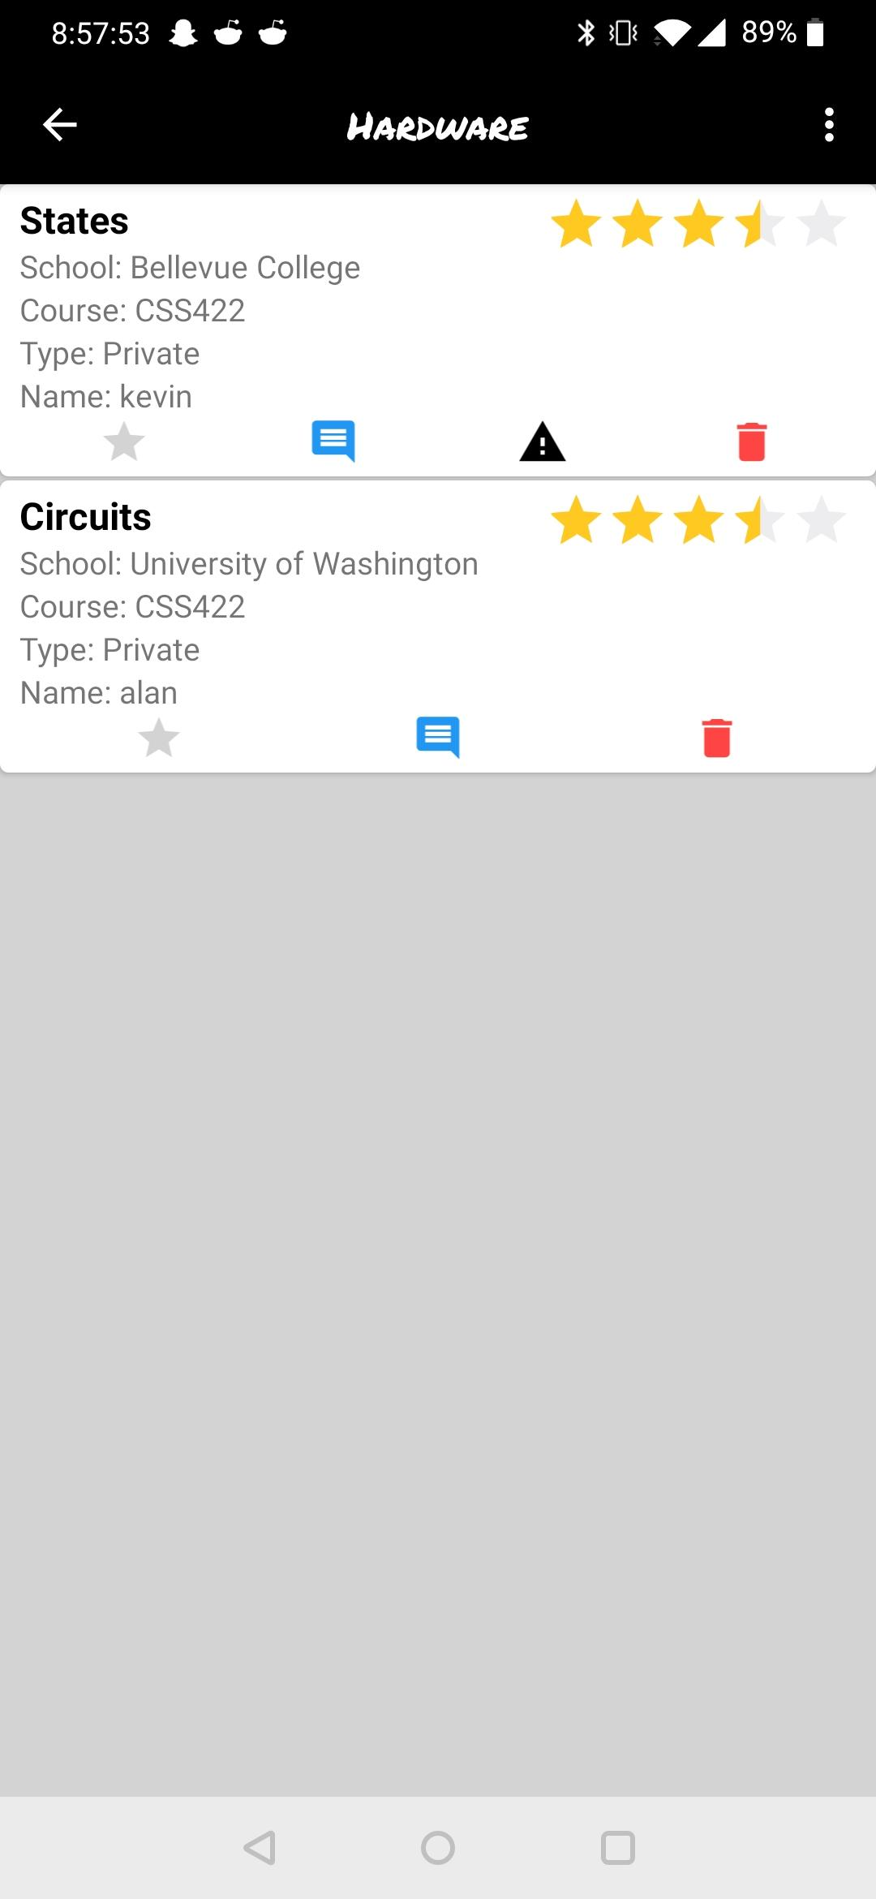
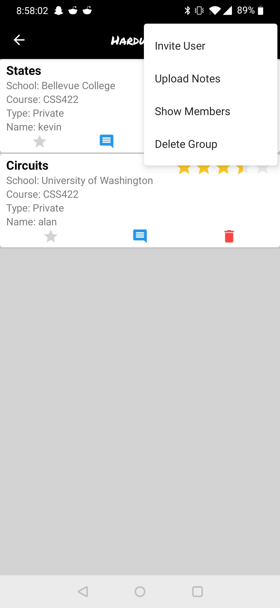
Inner Group View

Slide 21
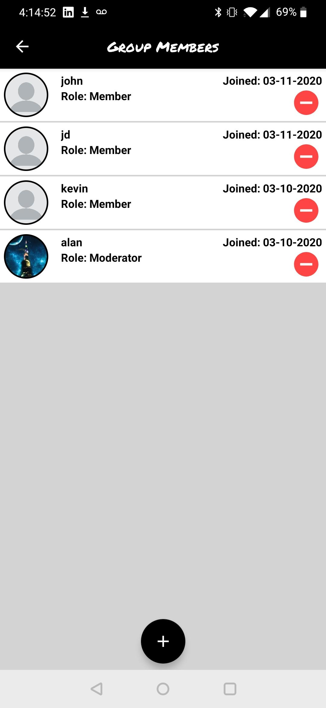
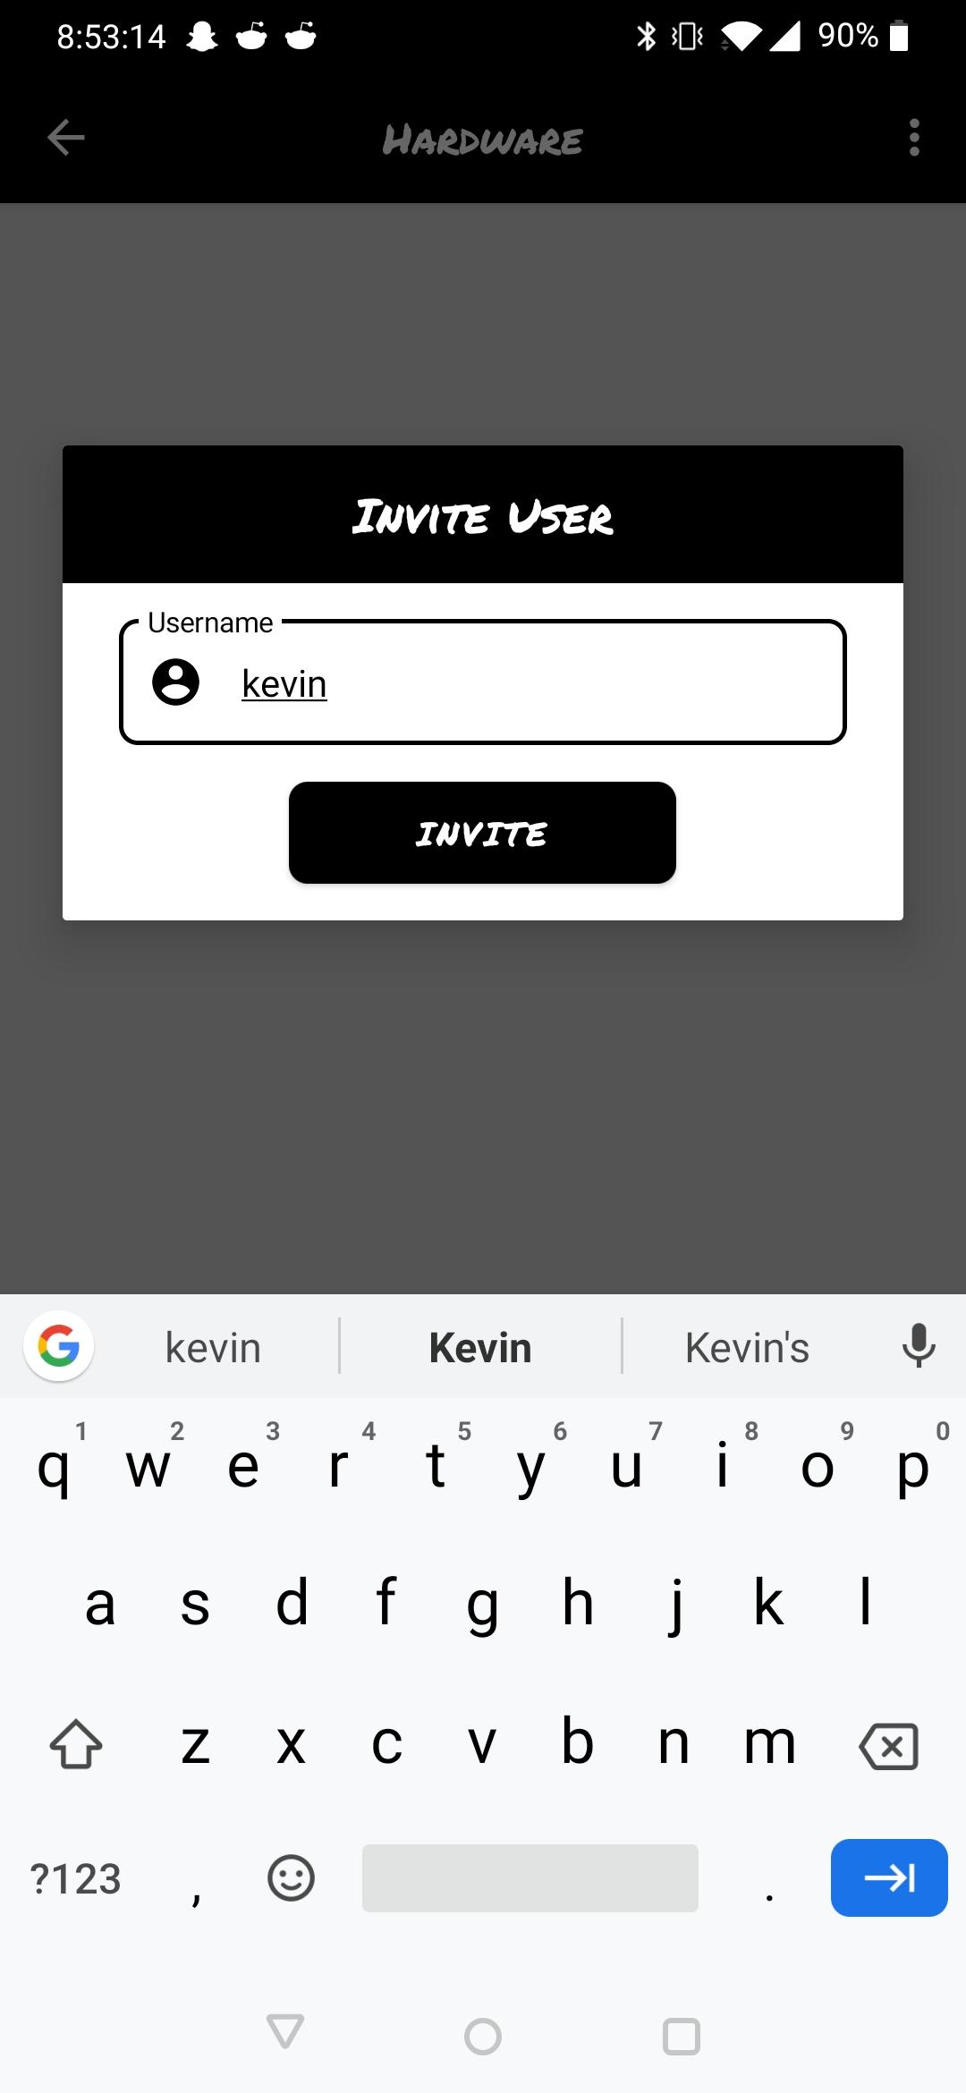
Inner Group Menu View

Slide 22
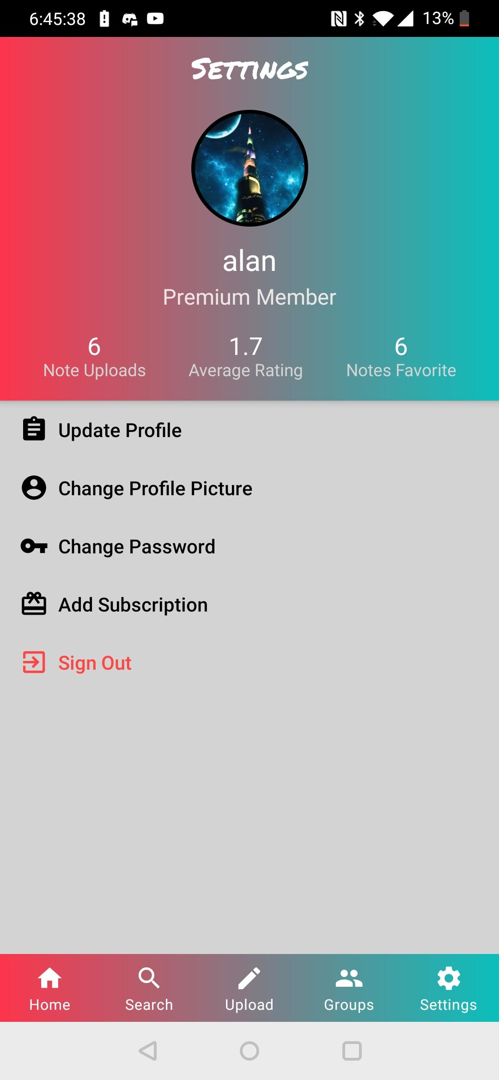
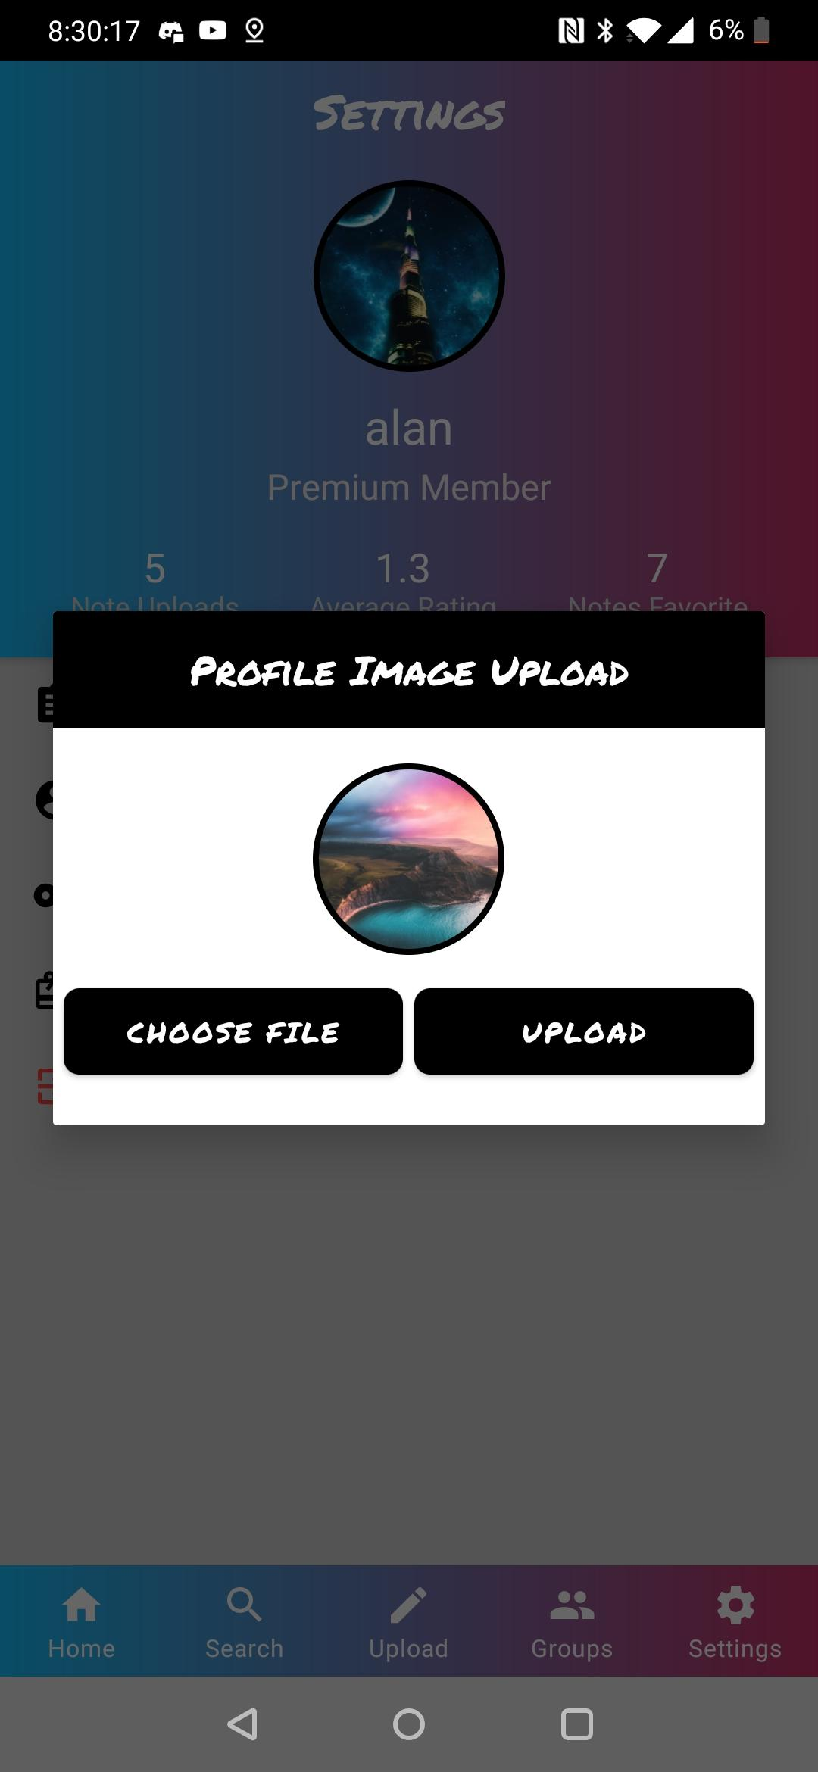
Settings

Slide 23
Back-End Development
04
Back-End Architecture

Slide 24
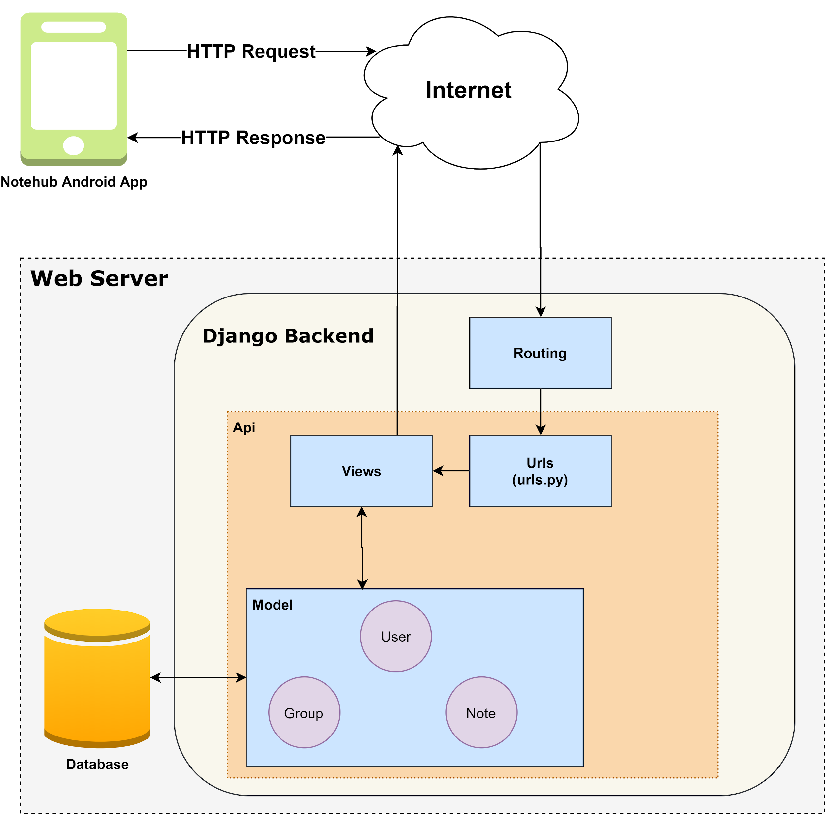
Architecture
App sends HTTP Requests to back-end server
Back-end server receives the request and performs the appropriate action
Back-end server sends response to the application

Slide 25
HTTP Request Methods
GET Request Example
GET
POST
PUT
PATCH
DELETE
GET /api/notes/ HTTP/1.1
Host: ec2-18-144-135-4.us-west-1.compute.amazonaws.com
POST Request Example
POST /api/notes/ HTTP/1.1
Host: ec2-18-144-135-4.us-west-1.compute.amazonaws.com
Content-Type: application/json
Authentication: Token 1234
Content-Length: 62
{"title":"CSS 350 CH 5","university":"57", "course":"CSS 350"}

Slide 26
REST API
REST: REpresentational State Transfer
Resource: is an abstraction of information
Resource Method: used to perform a desired action.
Endpoint: URL that is requested
5 Guiding Constraints:
Client-server architecture
Statelessness
Cacheability
Layered system
Uniform interface

Slide 27
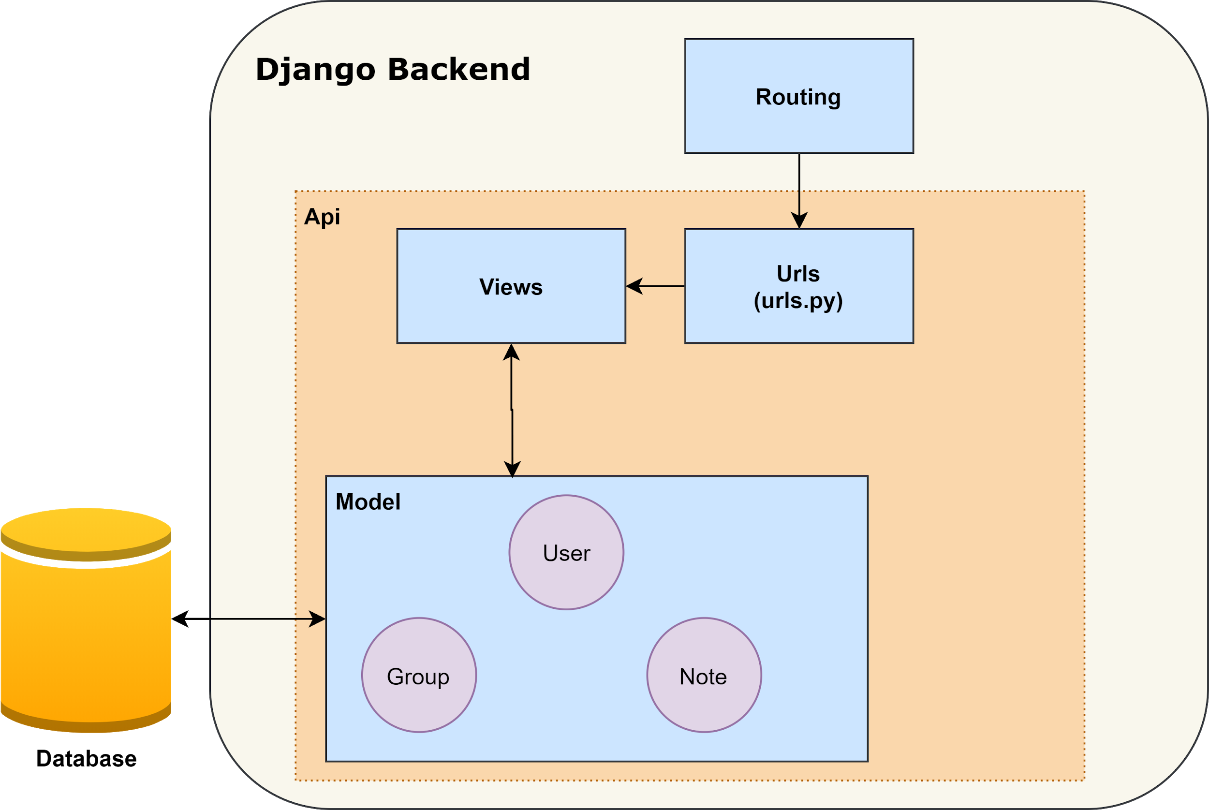
GET /api/notes/

Slide 28

API Endpoints (urls.py)
login/
user/
users/
notes/
universities/
groups/
notes/<int:note_id>/files/
notes/<int:note_id>/ratings/
notes/<int:note_id>/comments/
notes/<int:note_id>/favorites/
notes/<int:note_id>/report/

Slide 29
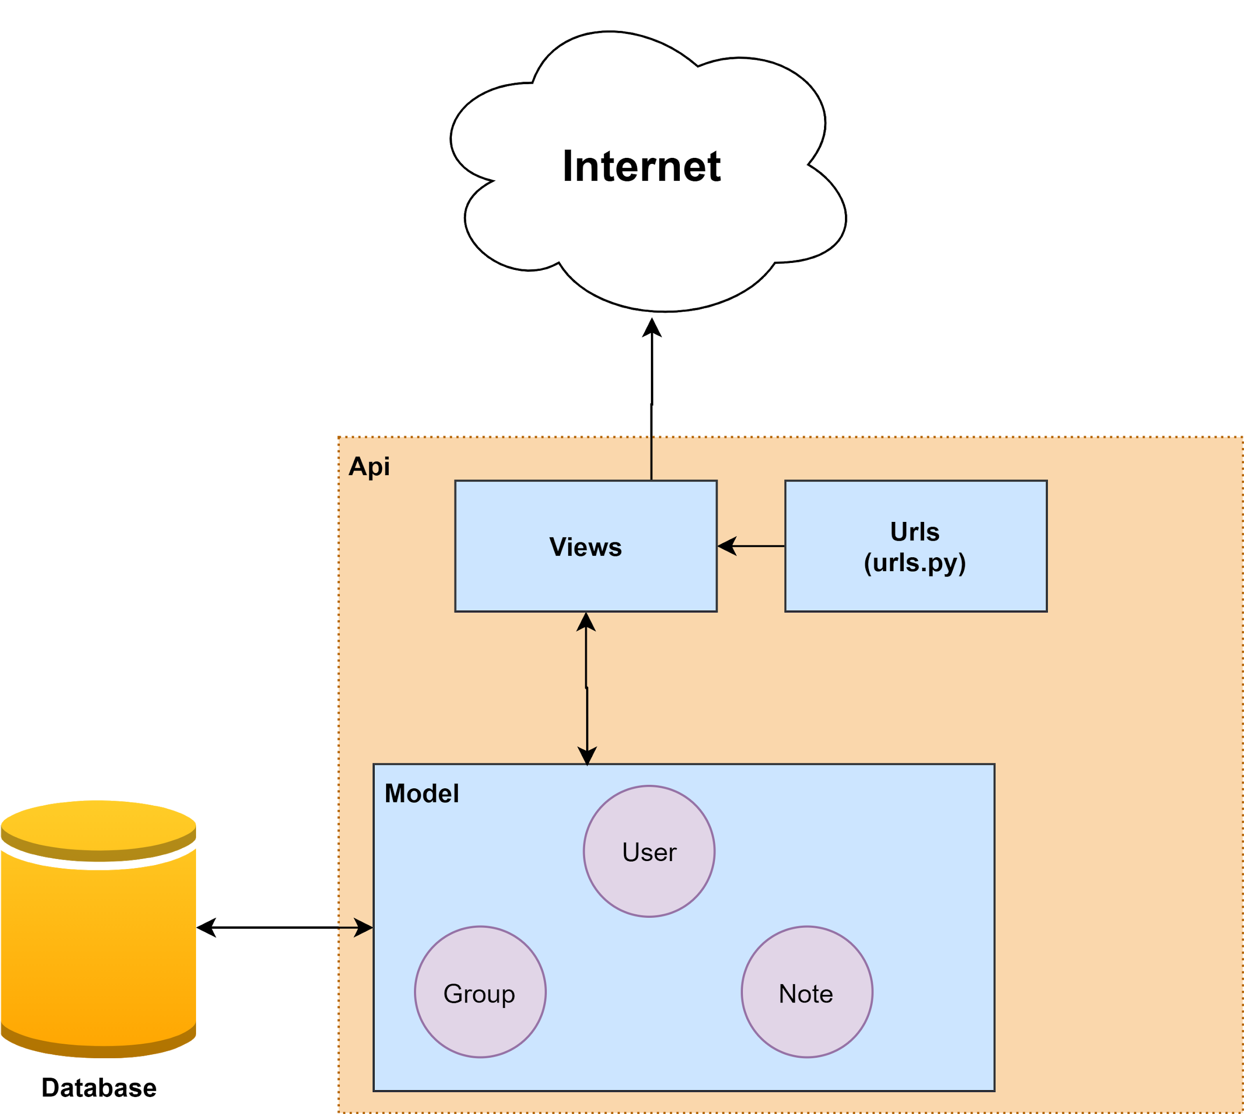
Model, Template, and View (MTV)
Model: Describes the data
View: Describes which data is presented
Templates: Describes how the data is presented

Slide 30
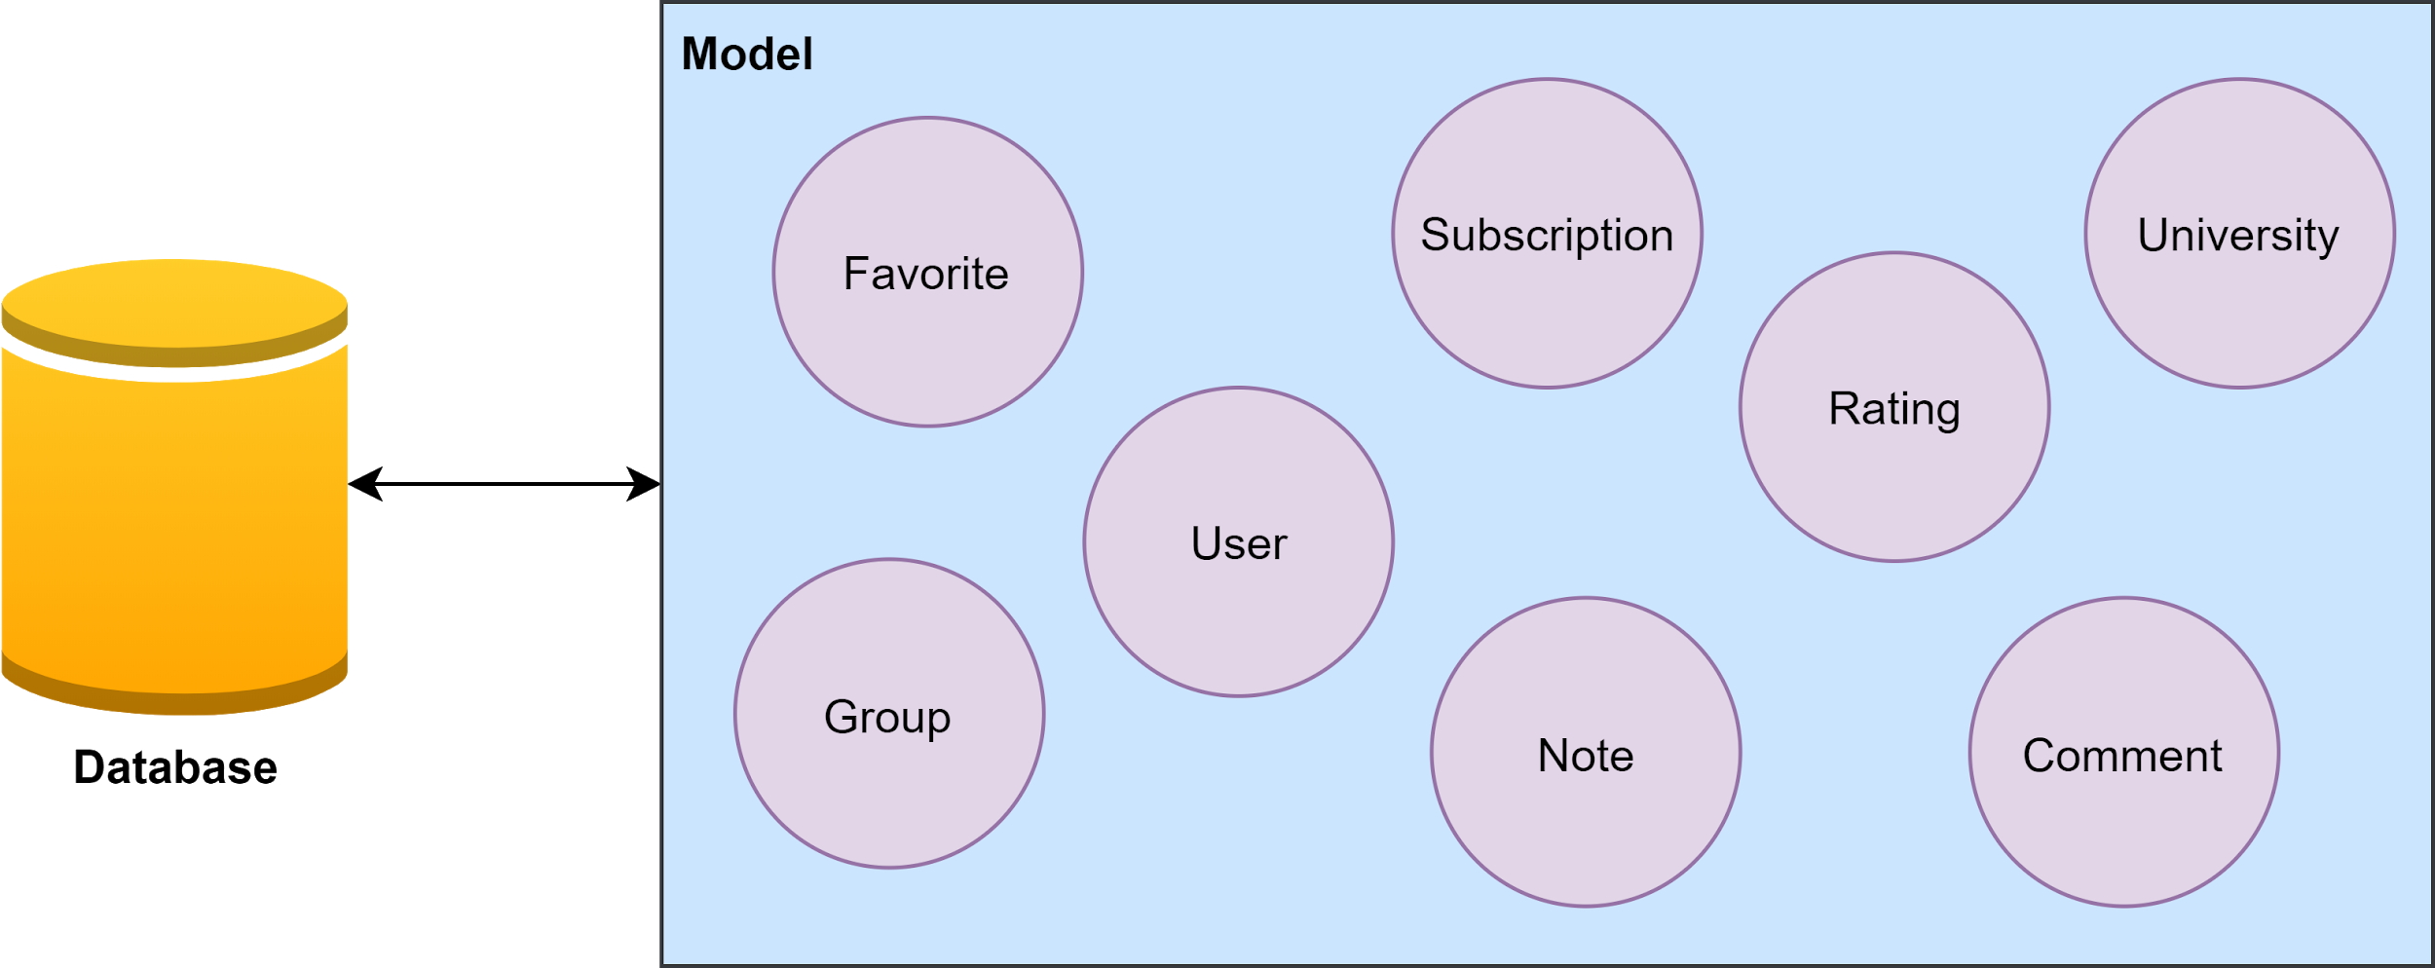
Object-relational mapping
Allows the use of an object-oriented paradigm to make queries.
Object attributes are mapped to table fields
Allows the use of objects to interact with the database

Slide 31
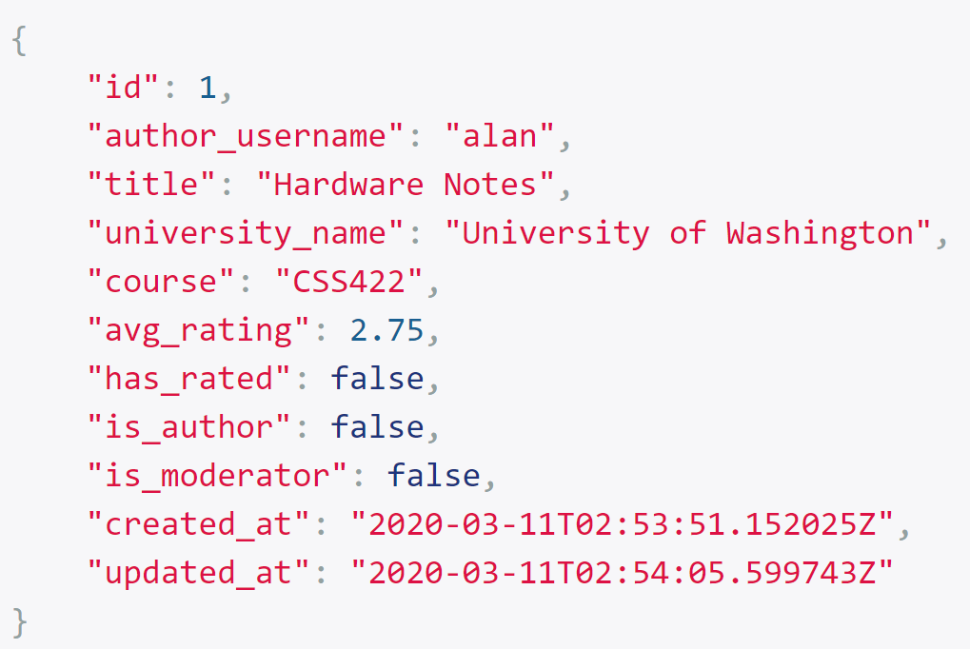
Response
HTTP responses can contain information as JSON
JSON represents data objects as readable text
Android application able to convert JSON into objects.

Slide 32
Usability Testing
05
Metrics: SUS, SEQ, & Completion
Student Feedback

Slide 33
Usability Testing
Setup:
17 volunteer testers
Test consists of 10 tasks
During the test, three different metrics will be measured
Usability Metrics:
Completion Rate
Task Level Satisfaction
Test Level Satisfaction

Slide 34
Tasks
Each task must be completed in less than 60 seconds:
Create account
Sign out of account
Upload note
Delete note
Create group
Invite user to group
Download note
Comment on note
Favorite and Report Note
Add subscription

Slide 35

Completion Rate
Success or Failure of each task is recorded
Calculated by dividing number of tasks completed by total tasks
Goal is for average completion rate to be 78% or greater
 | Create Account | Sign out | Upload Note | Delete Note | Create Group | Invite User | Download | Comment | Favorite & Report | Subscription | Total
Avg Completion Rate | 82.35% | 100.00% | 94.12% | 100.00% | 82.35% | 100.00% | 88.24% | 100.00% | 100.00% | 100.00% | 94.71%

Slide 36
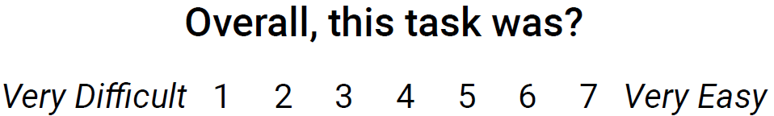
Task Level Satisfaction
Measured using a Single Ease Question (SEQ)
1-7 rating scale
Given after every task
Goal is for average SEQ score of 5.5 or greater
 | Create Account | Sign out | Upload Note | Delete Note | Create Group | Invite User | Download | Comment | Favorite & Report | Subscription
Avg SEQ Score | 6.5 | 6.6 | 5.4 | 6.4 | 5.4 | 6.2 | 5.9 | 6.3 | 6.2 | 6.6

Slide 37
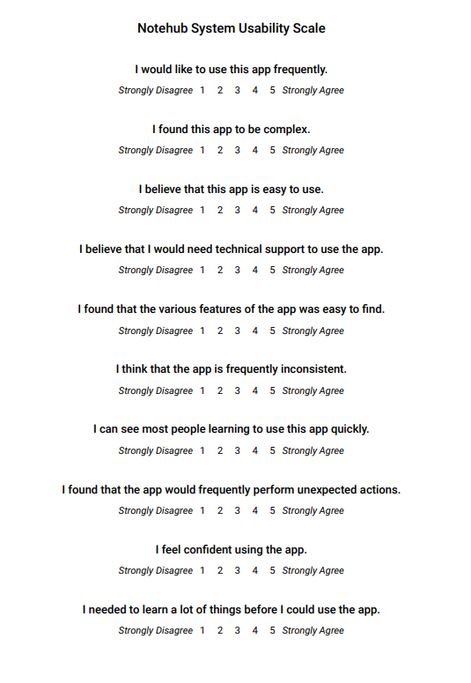
Test Level Satisfaction
Measured using a System Usability Scale (SUS)
10 questions
1-5 rating scale
Given at the end of the test
Goal is for average SEQ score of 68 or greater
Ended with an average SEQ score of 74

Slide 38
Students Feedback
—Aaron Vega
—Aden Shukuroff
—Nina Nguyen
“Only show the delete icon for other users’ notes.”
“I would separate the settings into sections.”
“The upload page should show all the note files.”

Slide 39
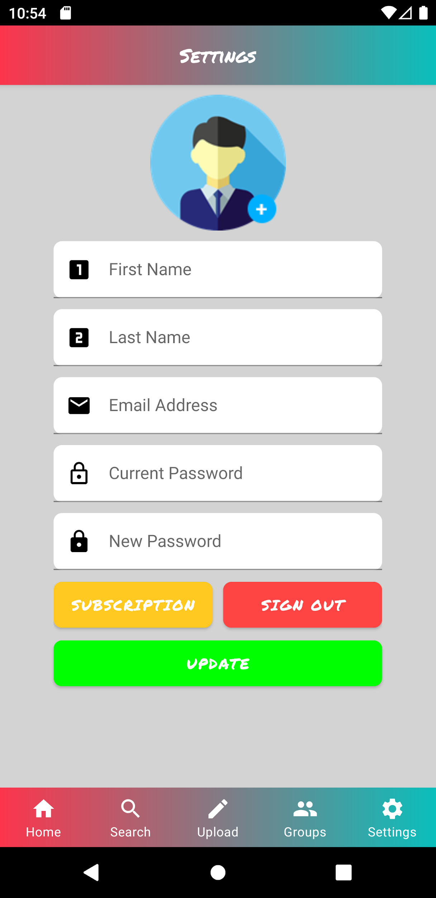
Implemented Students Feedback
Before
After

Slide 40
06
Experience
Helpful Courses & Knowledge Gained

Slide 41
Helpful Courses
CSS 342 & 343: Data Structures and Algorithms
CSS 360: Software Engineering
CSS 370: Analysis and Design
CSS 432: Computer Networking
CSS 475: Database Systems
CSS 480: Principles of Human-Computer Interaction

Slide 42
Knowledge Gained
Alan:
Android Studio IDE
Call APIs
Android application
JD:
Back-end using Django
Deploy a backend on a AWS server
Apache

Slide 43
THANKS
Do you have any questions?

Slide 44
